Slide 1
On Modern Statistical Methods for Genetic Association Study: Structured Genome-Transcriptome-Phenome Association Analysis
Eric P. Xing and Seyoung Kim
{epxing, sssykim}@cs.cmu.edu
Machine Learning Department
Lane Center for Computational Biology
School of Computer Science
Carnegie Mellon University
copyright © 2011 Eric P. Xing and Seyoung Kim

Slide 2
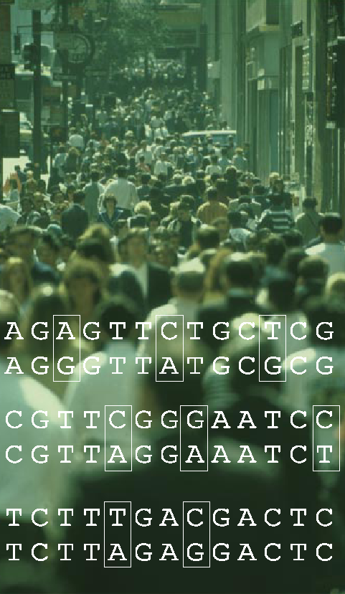
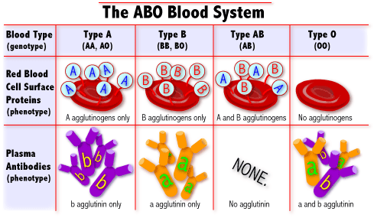
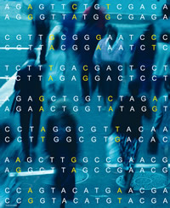
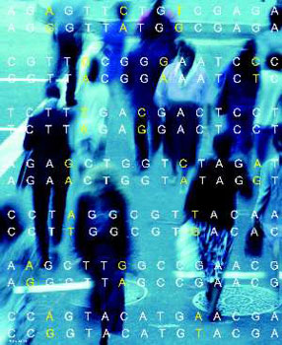
Genome Polymorphisms
Notes:
Refers to DNA level differences among individuals. For example, if you randomly pick to individual and sequence …

Slide 3
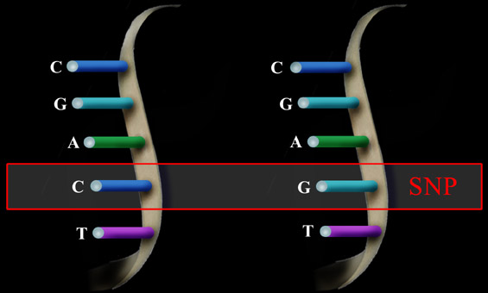
Type of Polymorphisms
Insertion/deletion of a section of DNA
Minisatellites: repeated base patterns (several hundred base pairs)
Microsatellites: 2-4 nucleotides repeated
Presence or absence of Alu segments
Single Nucleotide Polymorphism (SNP):
DNA sequence variation occurring when a single nucleotide - A, T, C, or G - differs between members of the species
Frequency of SNPs greater than that of any other type of polymorphism
Each variant is called an “allele”
Almost always bi-allelic
Account for most of the genetic diversity among different (normal) individual, e.g. drug response, disease susceptibility

Slide 4
A Human
Genealogy
TCGAGGTATTAAC
The ancestral chromosome

Slide 5
From
SNPS …
TCGAGGTATTAAC
TCTAGGTATTAAC
TCGAGGCATTAAC
TCTAGGTGTTAAC
TCGAGGTATTAGC
TCTAGGTATCAAC
* ** * *
The SNPs

Slide 6
… To
Haplotypes
TCGAGGTATTAAC
TCTAGGTATTAAC
TCGAGGCATTAAC
TCTAGGTGTTAAC
TCGAGGTATTAGC
TCTAGGTATCAAC
TC█AGG██T█A█C
TC█AGG██T█A█C
TC█AGG██T█A█C
TC█AGG██T█A█C
TC█AGG██T█A█C
TC█AGG██T█A█C
The haplotypes
A disease mutation
useful markers for studying disease association
-- landmarks, indicators, co-variates,
causes …

Slide 7
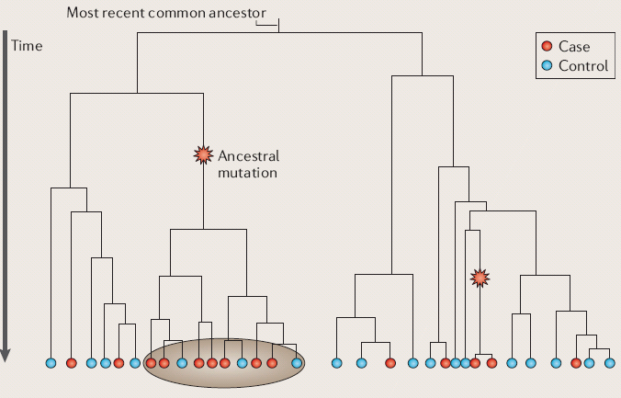
Population-Based Association Study
Case/control data are collected from unrelated individuals
All individuals are related if we go back far enough in the ancestry
Balding, Nature Reviews Genetics, 2006

Slide 8
Advantages of SNPs in Genetic Analysis of Complex Traits
Abundance: high frequency on the genome
Position: throughout the genome
coding region, intron region, promoter site
Ease of genotyping
Less mutable than other forms of polymorphisms
SNPs account for around 90% of human genomic variation
About 10 million SNPs exist in human populations
Most SNPs are outside of the protein coding regions
1 SNP every 600 base pairs
More than 5 million common SNPs each with frequency 10-50% account for the bulk of human DNA sequence difference
It is estimated that ~60,000 SNPs occur within exons; 85% of exons are within 5 kb of the nearest SNP

Slide 9
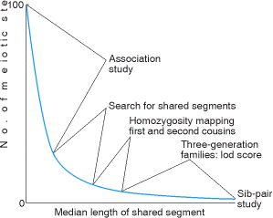
Linkage Analysis vs. Association Analysis
Strachan & Read, Human Molecular Genetics, 2001

Slide 10
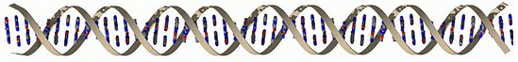



Genetic Basis of Diseases
ACTCGTACGTAGACCTAGCATTACGCAATAATGCGA
Healthy
ACTCGAACCTAGACCTAGCATTACGCAATAATGCGA
TCTCGTACGTAGACGTAGCATTACGCAATTATCCGA
ACTCGAACCTAGACCTAGCATTACGCAATTATCCGA
ACTCGTACGTAGACGTAGCATAACGCAATAATGCGA
TCTCGTACCTAGACGTAGCATAACGCAATAATCCGA
Sick
ACTCGAACCTAGACCTAGCATAACGCAATTATCCGA
Single nucleotide polymorphism (SNP)
Association SNP

Slide 11
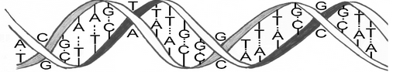


Genetic Association Mapping
Data
Genotype
Phenotype
Standard Approach
A . . . . T . . G . . . . . C . . . . . . T . . . . . A . . G .
A . . . . A . . C . . . . . C . . . . . . T . . . . . A . . G .
causal SNP
T . . . . T . . G . . . . . G . . . . . . T . . . . . T . . C .
A . . . . A . . C . . . . . C . . . . . . T . . . . . T . . C .
A . . . . T . . G . . . . . G . . . . . . A . . . . . A . . G .
T . . . . T . . C . . . . . G . . . . . . A . . . . . A . . C .
a univariate phenotype:
e.g., disease/control
A . . . . A . . C . . . . . C . . . . . . A . . . . . T . . C .
Cancer: Dunning et al. 2009.
Diabetes: Dupuis et al. 2010.
Atopic dermatitis: Esparza-Gordillo et al. 2009.
Arthritis: Suzuki et al. 2008
Notes:
In order to find this causal snps …you scan the genome with a test statistics at snps at a time …

Slide 12
Genetic Basis of Complex Diseases
ACTCGTACGTAGACCTAGCATTACGCAATAATGCGA
Healthy
ACTCGAACCTAGACCTAGCATTACGCAATAATGCGA
TCTCGTACGTAGACGTAGCATTACGCAATTATCCGA
ACTCGAACCTAGACCTAGCATTACGCAATTATCCGA
ACTCGTACGTAGACGTAGCATAACGCAATAATGCGA
TCTCGTACCTAGACGTAGCATAACGCAATAATCCGA
Cancer
ACTCGAACCTAGACCTAGCATAACGCAATTATCCGA
Causal SNPs

Slide 13

Genetic Basis of Complex Diseases
Healthy
ACTCGTACGTAGACCTAGCATTACGCAATAATGCGA
?
ACTCGAACCTAGACCTAGCATTACGCAATAATGCGA
Biological mechanism
TCTCGTACGTAGACGTAGCATTACGCAATTATCCGA
ACTCGAACCTAGACCTAGCATTACGCAATTATCCGA
ACTCGTACGTAGACGTAGCATAACGCAATAATGCGA
TCTCGTACCTAGACGTAGCATAACGCAATAATCCGA
ACTCGAACCTAGACCTAGCATAACGCAATTATCCGA
Cancer
Causal SNPs
Notes:
And a complex disease has multiple symptoms or trait, and every snips are not equally associated to all traits, instead …

Slide 14
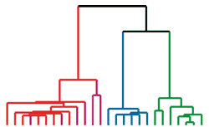
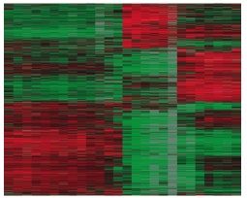
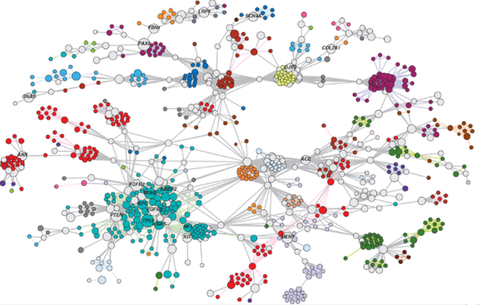

Genetic Basis of Complex Diseases
Association to intermediate phenotypes
Intermediate Phenotype
Gene expression
ACTCGTACGTAGACCTAGCATTACGCAATAATGCGA
Healthy
ACTCGAACCTAGACCTAGCATTACGCAATAATGCGA
TCTCGTACGTAGACGTAGCATTACGCAATTATCCGA
ACTCGAACCTAGACCTAGCATTACGCAATTATCCGA
ACTCGTACGTAGACGTAGCATAACGCAATAATGCGA
TCTCGTACCTAGACGTAGCATAACGCAATAATCCGA
ACTCGAACCTAGACCTAGCATAACGCAATTATCCGA
Clinical records
Cancer
Causal SNPs

Slide 15
Population association analysis
Standard Approach
New Approach
Consider multiple correlated phenotypes (phenome) and genotypes (genome) jointly
Consider
one phenotype at a time
vs.
Phenotypes
Phenome

Slide 16
Summary: Structured Genome-Transcriptome-Phenome Association Analysis
Genome Structure
Phenome Structure
Epistasis
Population structure
Incorporating prior knowledge
Trait network
Dynamic trait analysis
Transcriptome Structure
Exploiting gene-interaction network
Exploiting a hierarchical clustering tree of genes
Temporal modeling across time
Notes:
yes

Slide 17
Outline
Preparing Data for Association Analysis
Missing genotypes/phenotypes, tag SNP selection, haplotype inference, population structure
Background on Association Analysis: Single Phenotype Methods
Single SNP approach : case/control study, quantitative trait as phenotype
Simultaneous analysis of all SNPs: Sparse regression method
Structured Geome-Phenome-Transcriptome Analysis
Exploiting genome structure in association analysis
Linkage disequilibrium, population structure, epistasis
Exploiting transcriptome structure in association analysis
Pleiotropy : Pathway-based statistical tests
Leveraging trait structures: graph and tree
Exploiting phenome structure in association analysis
Pleiotropy, dynamic-trait association
Two-way structured association
Three-way structured association
Association Analysis and Next-generation Sequencing
Going beyond SNPs: Structural variants
From common variants to rare variants
G
T
P
G
T
G
P
T
P
G
T
P

Slide 18
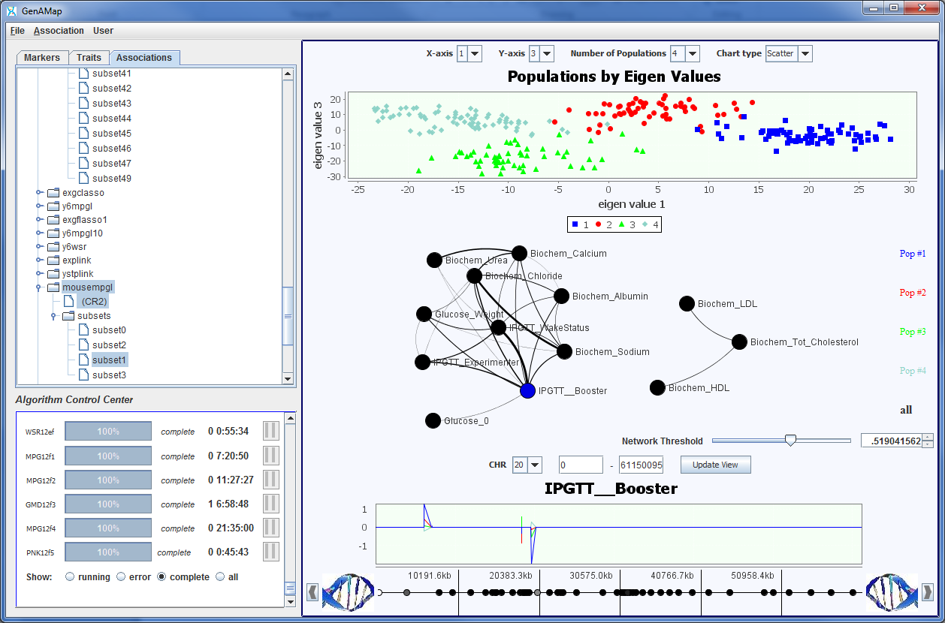
GenAMap: Visual analytics software for structured association mapping Curtis and Xing, Carnegie Mellon University
1) Data Management
3) Integrated visualization tools
2) Algorithm Automation

Slide 19
Part I
Preparing Data for Association Analysis

Slide 20
Overview
Preparing genotype data
Haplotype inference
Tag SNP selection
How to handle missing genotype values
Population structure
Preparing phenotype data
How to handle missing phenotype values
Data normalization
What structure?

Slide 21
Haplotype and Genotype
A collection of alleles derived from the same chromosome
Genotypes
Haplotypes
2
1
3
2
1
3
1
6
6
1
9
1
5
9
1
5
4
1
7
1
7
4
1
9
Haplotype
Re-construction
1
9
2
6
6
2
9
1
7
9
1
7
2
1
2
2
1
2
7
1
2
1
2
7
6
1
4
1
4
6
1
7
7
1
1
8
1
8
1
8
1
8
1
4
1
4
1
0
1
0
1
0
1
0
Chromosome phase is unknown
Chromosome phase is known

Slide 22
Why Haplotype in Association Mapping? -- a more discriminative state of a chromosomal region
GATCTTCGTACTGAGT
GATCTTCGTACTGAGT
GATTTTCGTACGGAAT
GATTTTCGTACTGAGT
GATCTTCGTACTGAAT
GATTTTCGTACGGAAT
GATTTTCGTACGGAAT
GATCTTCGTACTGAAT
Haplotype
CTG 3/8
TGA 3/8
CTA 2/8
healthy
healthy
disease X
chromosome
Consider J binary markers in a genomic region
There are 2^{J} possible haplotypes
but in fact, far fewer are seen in human population
Good genetic marker for population, evolution and hereditary diseases …

Slide 23
Haplotype Analyses
Haplotype analyses
Linkage disequilibrium assessment
Disease-gene discovery
Genetic demography
Chromosomal evolution studies
Why Haplotypes
Haplotypes are more powerful discriminators between cases and controls in disease association studies
Use of haplotypes in disease association studies reduces the number of tests to be carried out.

Slide 24
Linkage Disequilibrium
LD reflects the relationship between alleles at different loci.
Alleles at locus A: frequencies p₁,…, p_{m}
Alleles at locus B: frequencies q₁,…,q_{n}
Haplotype frequency for A_{i}B_{j}:
equilibrium value: p_{i} q_{j}
Observed value: h_{ij}
Linkage disequilibrium: h_{ij} -p_{i} q_{j}
Linkage disequilibrium is an allelic association measure (difference between the actual haplotype frequency and the equilibrium value)
More precisely: gametic association
Association studies.
If inheriting a certain allele at the disease locus increases the chance of getting the disease, and the disease and marker loci are in LD, then the frequencies of the marker alleles will differ between diseased and non-diseased individuals.

Slide 25
Haplotype Inference
Given a random sample of multilocus genotypes at a set of SNPs
Frequency estimation of all possible haplotypes
Haplotype reconstruction for individuals
How many out of all possible haplotypes are plausible in a population
Haplotype reconstruction algorithm
Clark’s parsimony algorithm (Clark, Mol. Biol. Evol. 1990)
Haplotyper (Niu et al., AJHG 2002)
PHASE (Stephens et al., AJHG 2001)

Slide 26
PHASE (Stephens et al., AJHG 2001)
Treat unknown haplotypes as unobserved random quantities and estimate the conditional probability of haplotypes given observed genotypes
Gibbs sampling approach
Start with initial guesses on haplotypes
Iteratively reconstruct the haplotype of each individual assuming the haplotypes of other individuals have been correctly reconstructed.

Slide 27
PHASE (Stephens et al., AJHG 2001)
Given the genotype data G, start with some initial haplotype reconstruction H⁽⁰⁾. For t = 0, 1, 2, …, obtain H^{(t+1)} from H^{(t)} using the following three steps:
1. Choose an individual, i, uniformly and at random from all ambiguous individuals (i.e., individuals with more than one possible haplotype reconstruction).
2. Sample H_{i}^{(t+1)} from P(H_{i}|G,H_{-i}^{(t)}), where H_{-i} is the set of haplotypes excluding individual i.
3. Set H_{j}^{(t+1)} = H_{j}^{(t)} for j=1,…,n, j ≠ i

Slide 28
Reducing Genotyping Costs with Tag SNPs
Nearby SNPs in the genome are in linkage disequilibrium (LD), and thus contain redundant information.
If we knew which SNPs are in LD, we can pre-select the representative SNPs for each LD block of chromosome, and genotype only for those SNPs.

Slide 29
Two-phase Genotyping Using Tag SNPs
A two-phase approach
Phase 1: Collect a set of SNPs densely distributed across genome for a small number of individuals. Select tag SNPs based on this dataset.
Phase 2: Genotype only for tag SNPs for a large number of individuals

Slide 30
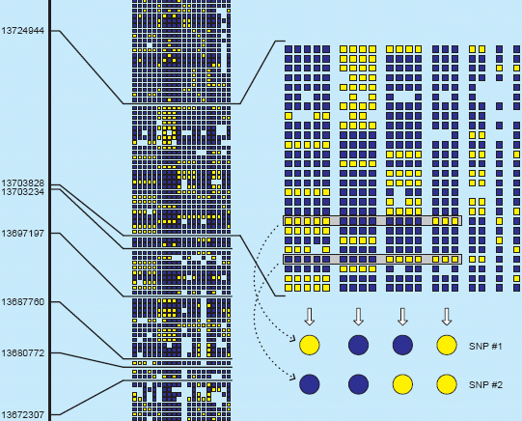
Tag SNP Selection
Tag SNPs summarize information across multiple SNPs in linkage disequilibrium
Patil et al., Science 2001

Slide 31
Algorithm for Finding Tag SNP
Problem: Find a set of tag SNPs that cover all of the non-tag SNPs in LD (r²>α) with the tag SNPs
α : parameter that needs to be specified by the user (e.g., 0.8)
Greedy search (Carlson et al., AJHG 2004)
Repeatedly select the SNP that cover the largest number of non-tag SNPs given α
Dynamic programming approach (Zhang et al., PNAS 2002)

Slide 32
What is population structure?
Population Structure
A set of individuals characterized by some measure of genetic distinction
A “population” is usually characterized by a distinct distribution over genotypes
Example
Genotypes aa aA AA
Population 1
Population 2

Slide 33
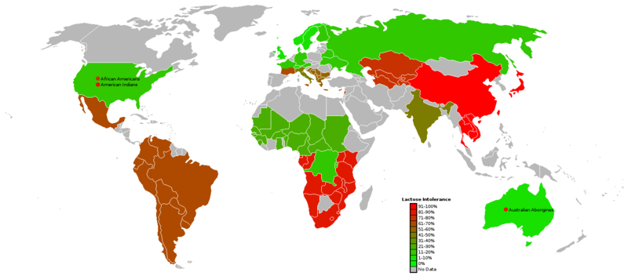
Motivation
Reconstructing individual ancestry: The Genographic Project
https://genographic.nationalgeographic.com/genographic/index.html
Studying human migration
Out of Africa
Multi-regional hypothesis
Study of various traits
Lactose intolerance
Origins in Europe?
Infer from
Migration studies
Mutation studies in populations

Slide 34
Methods for Learning Population Structure from Genetic Markers
Low-dimensional projection
PCA-based methods (Patterson et al., PLoS Genetics 2006)
Clustering
Distance-based (Bowcock et al., Nature 1994)
Model-based
STRUCTURE (Pritchard et al., Genetics 2000)
mStruct (Shringarpure & Xing, Genetics 2008)

Slide 35
Low-dimensional Projections
Genetic data is very large
Number of markers may range from a few hundreds to hundreds of thousands
Thus each individual is described by a high-dimensional vector of marker configurations
A low-dimensional projection allows easy visualization
Technique used
Factor analysis
Many statistical methods exist – ICA, PCA, NMF etc.
Principal Components Analysis (next slide)
Allows projection of individuals into a low dimensional space
Usually projected to 2 dimensions to allow visualization

Slide 36
Principal Component Analysis
Most common form of factor analysis
The new variables/dimensions ...
Are linear combinations of the original ones
Are uncorrelated with one another
Orthogonal in original dimension space
Capture as much of the original variance in the data as possible
Are called Principal Components
Demo at http://www.cs.mcgill.ca/~sqrt/dimr/dimreduction.html

Slide 37
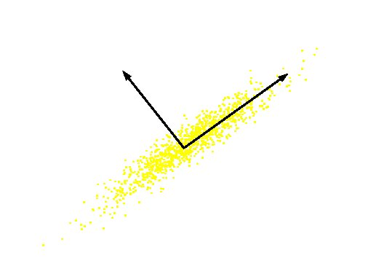
What are the new axes?
PC 2
PC 1
Original Variable B
Original Variable A
Orthogonal directions of greatest variance in data
Projections along PC1 discriminate the data most along any one axis

Slide 38
Dimensionality Reduction
Can ignore the components of lesser significance.
You do lose some information, but if the eigenvalues are small, you don’t lose much
n dimensions in original data
calculate n eigenvectors and eigenvalues
choose only the first p eigenvectors, based on their eigenvalues
final data set has only p dimensions

Slide 39
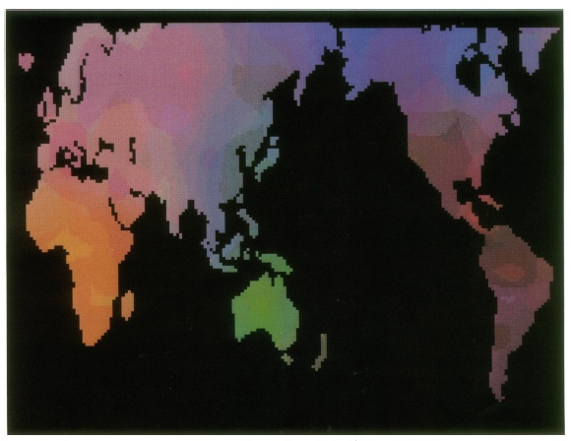
PCA Analysis (Cavalli-sforza,1978)
Plot of geographical distribution of 3 PCs (Intensity proportional to value of each component)
First – blue
Second - green
Third - red

Slide 40
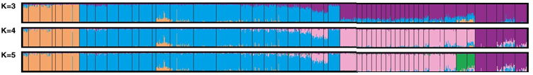
Model-based Clustering for Discovering Population Structure
Ancestral proportion
Africa
Europe
Mid-East
Cent./S. Asia
East Asia
Oceania
Genetic structure of Human Populations (Rosenberg et al., Science 2002)‏
How to display population structure?
Structure (Pritchard et al., Genetics 2000)‏
Notes:
40

Slide 41
Structure Model
Hypothesis: Modern populations are created by an intermixing of ancestral populations.
An individual’s genome contains contributions from one or more ancestral populations.
The contributions of populations can be different for different individuals.
Other assumptions
Hardy-weinberg equilbrium
No linkage disequilbrium
Markers are i.i.d (independent and identically distributed)

Slide 42
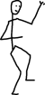
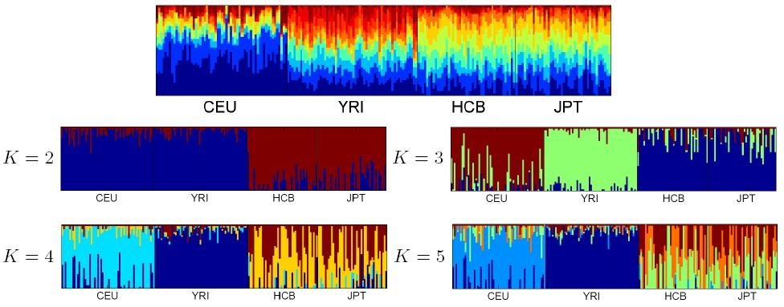

The Admixture Model
Admixture of "ancestral frequency profiles (AP)"
No distinction between ancestral and current alleles
Does not model mutation and chromosomal recombination
Ancestral populations represented as allele frequency profiles
Structure 2.1
0.3
0.4
0.3
0.02
0.02
0.08
0.5
0.2
0.3
0.08
0.90
0.1
0.7
0.2
0.90

Slide 43
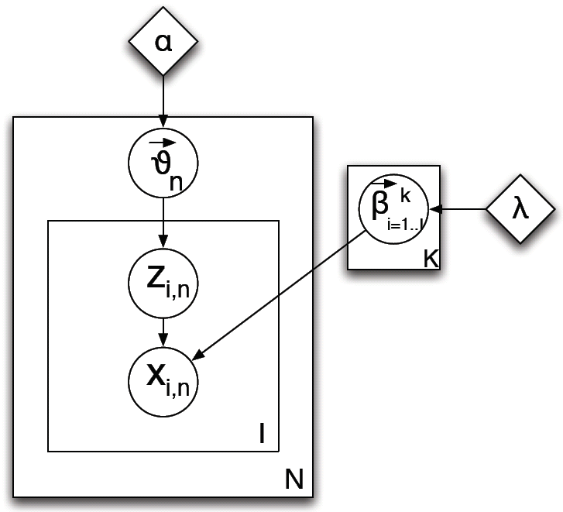
The Admixture Model
β = Distribution over alleles
One per population –locus pair
To generate an individual’s genome
Sample θ from Dirichlet(α)
For each locus
Sample z from Multinomial(θ)
Sample x from β corresponding to the population chosen by z

Slide 44
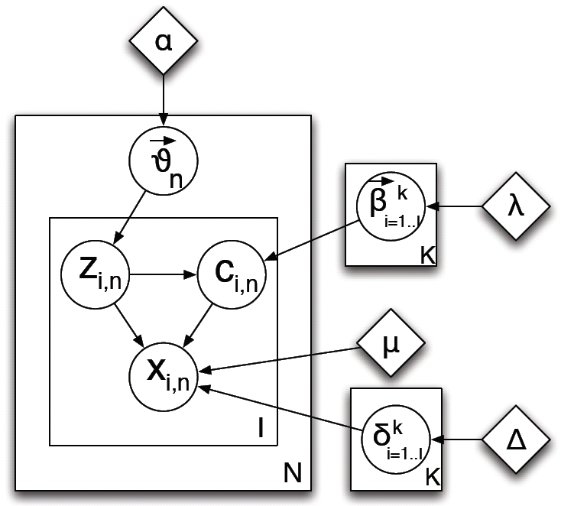
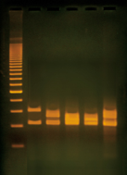
From Structure to mStruct : Modelling Mutations
From admixture of APs to admixture of MIMs
MiM: population-specific Mixture of Inheritance Models
The inheritance model:
Microsatellite: SNPs:

Slide 45
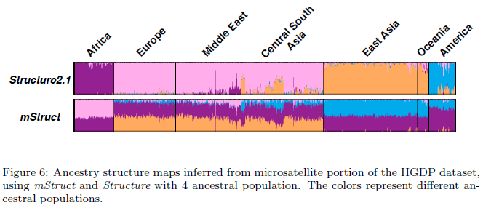
Comparing Population Structure Maps
A common ancestral population is now seen across all continents!
Clusters remain unchanged

Slide 46
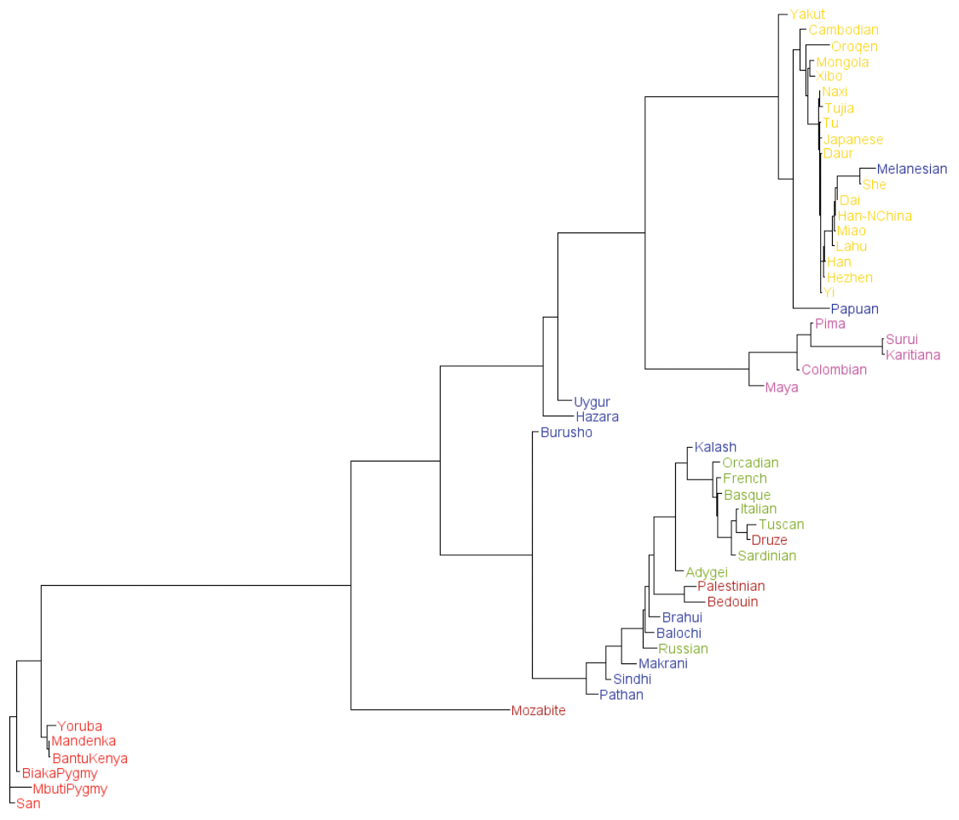
Phylogenetic tree from mStruct Structural map

Slide 47
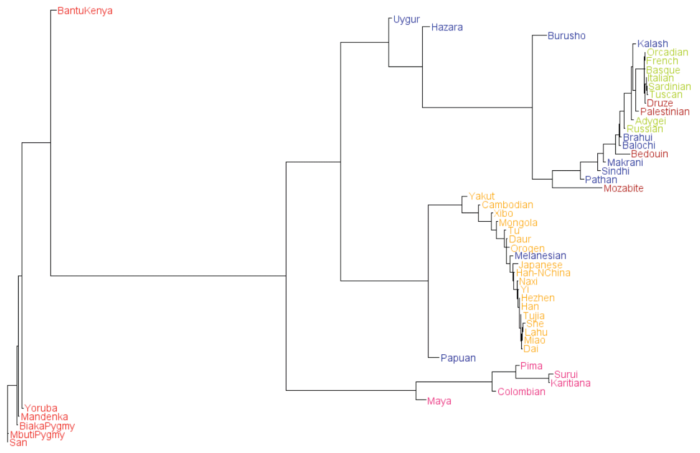
Neighbour-joining Phylogenetic Trees from the Structural Maps
mStruct
Structure

Slide 48
Comparison of Different Methods
 | PCA | Model-based Clustering (Structure, mStruct)
Advantages | Statistical tests for significance of results (Patterson et al. 2006) Easy visualization | Generative process that explicitly models admixture Clustering is probabilistic: it is possible to assign confidence level of clusters
Disadvantages | No intuition about underlying processes | Computational more demanding Based on assumptions of evolutionary models: Structure: No models of mutation, recombination Mutation added in mStruct Recombination added in extension by Falush et al.
Notes:
Yes. Need one more conclusion slide after this one.

Slide 49
Summary: data preparation
Preparing genotype data
Haplotypes inferred
Tag SNP selected
Missing genotype values imputed
Population structures stratified
Preparing phenotype data
Handle missing phenotype values
Data normalization
Structure discovery: network inference, hierarchical clustering

Slide 50
Part II
Background on Association Analysis: Single Phenotype Method

Slide 51
Overview
Single SNP association test
Discrete-valued phenotype: case/control study
Continuous-valued phenotype: quantitative traits
Correcting for multiple testing
Simultaneous analysis of all SNPs
Sparse regression method and convex optimization

Slide 52
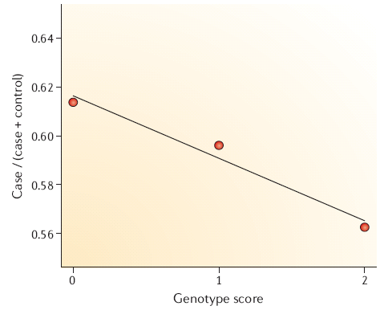
Single SNP Association Analysis: Case/Control Study
For each marker locus, find the 3x2 contingency table containing the counts of three genotypes
test with 2 df, or Fisher’s exact test under the null hypothesis of no association
Genotype | Case | Control
AA | Ncase,AA | Ncontrol,AA
Aa | Ncase,Aa | Ncontrol,Aa
aa | Ncase,aa | Ncontrol,aa
Total | Ncase | Ncontrol
Genotype score = the number of minor alleles

Slide 53
Single SNP Association Analysis: Case/Control Study
Alternatively, assume an additive model, where the heterozygote risk is approximately between the two homozygotes
Form a 2x2 contingency table. Each individual contributes twice from each of the two chromosomes.
test with 1df
Genotype | Case | Control
A | Gcase,A | Gcontrol,A
a | Gcase,a | Gcontrol,a
Total | 2xNcase | 2xNcontrol

Slide 54
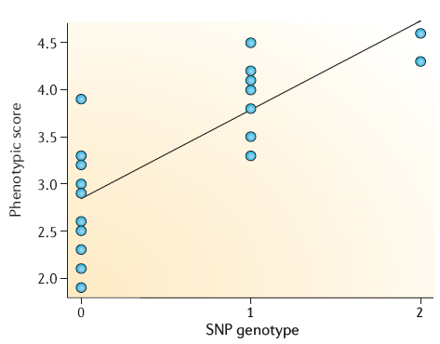
Single SNP Association Analysis: Continuous-valued Traits
Continuous-valued traits
Also called quantitative traits
Cholesterol level, blood pressure etc.
For each locus, fit a linear regression using the number of minor alleles at the given locus of the individual as covariate

Slide 55
A Tree Analysis of Mouse eQTL Dataset
NIH heterogeneous stock of mice (Johannesson et al., Genome Research 2009)
259 mice from 7 inbred strains (A/J, AKR/J, BALBc/J, CBA/J, C3H/HeJ, C57BL/6J, DBA/2J and LP/J)
9742 gene expression
12545 SNPs

Slide 56
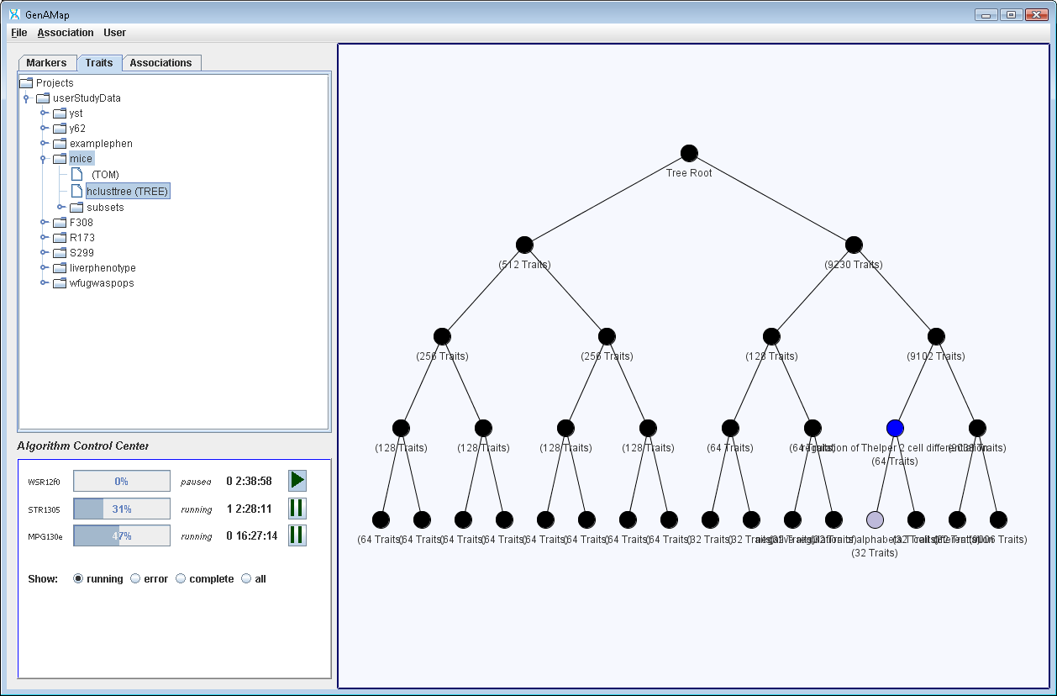
Genes displayed as a hierarchical tree
Non-leaf nodes are labeled and colored by GO enrichment and the number of traits they represent.
Genes are the leaves of the tree.

Slide 57
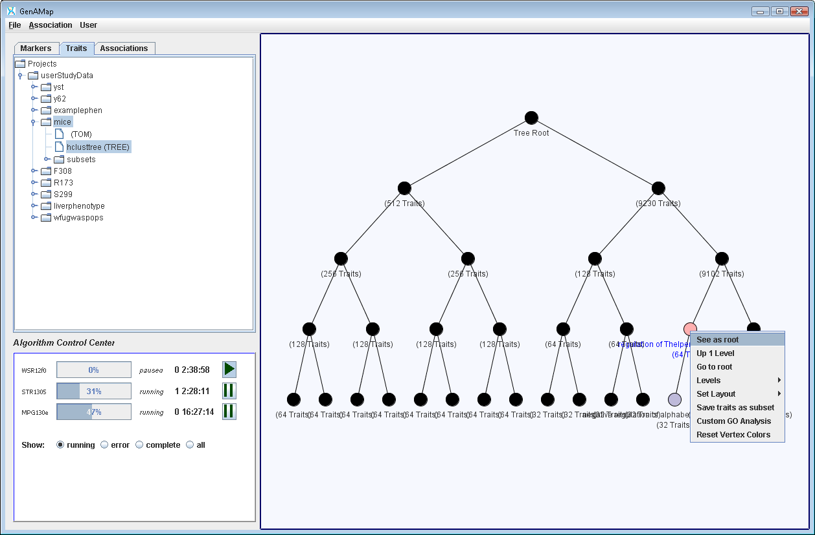
Browsing through the tree

Slide 58
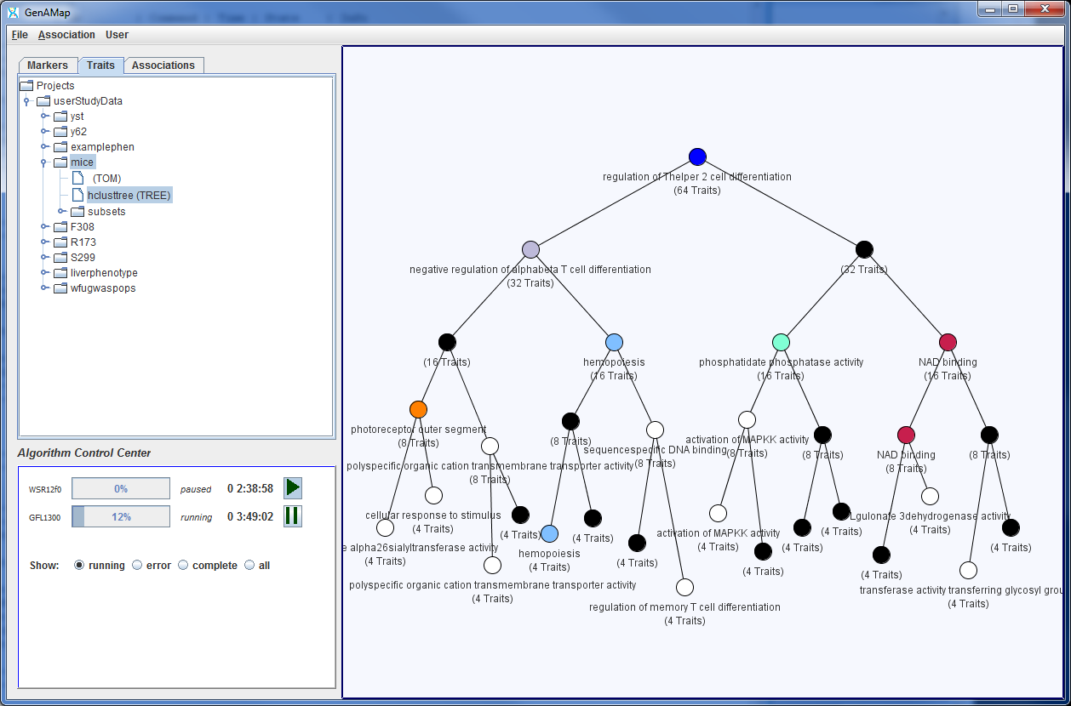
Branches of the tree are enriched for a common GO category

Slide 59
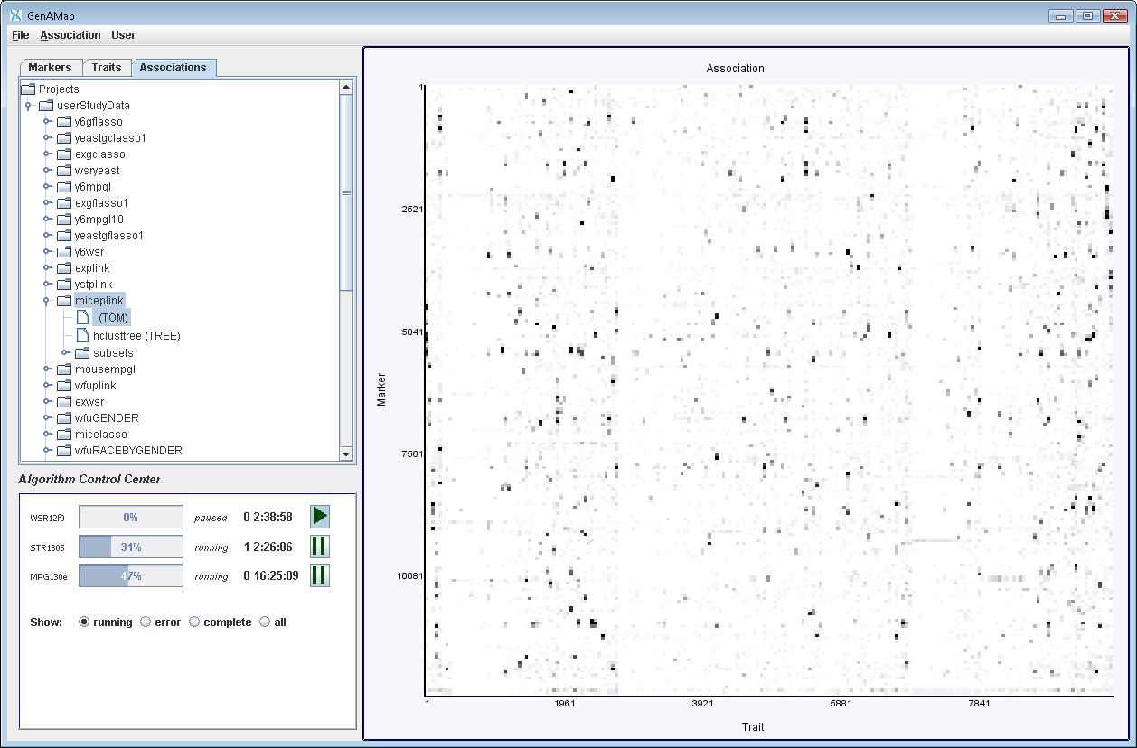
Association results ( - log p-value)

Slide 60
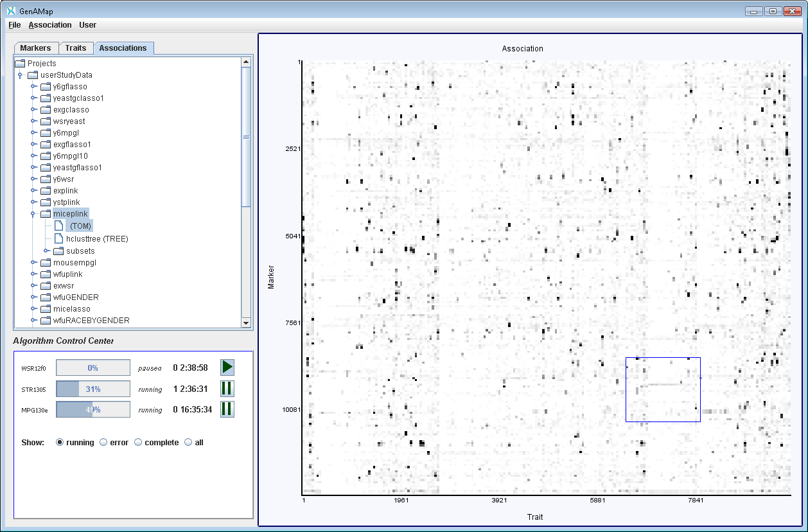
eQTL hotspot

Slide 61
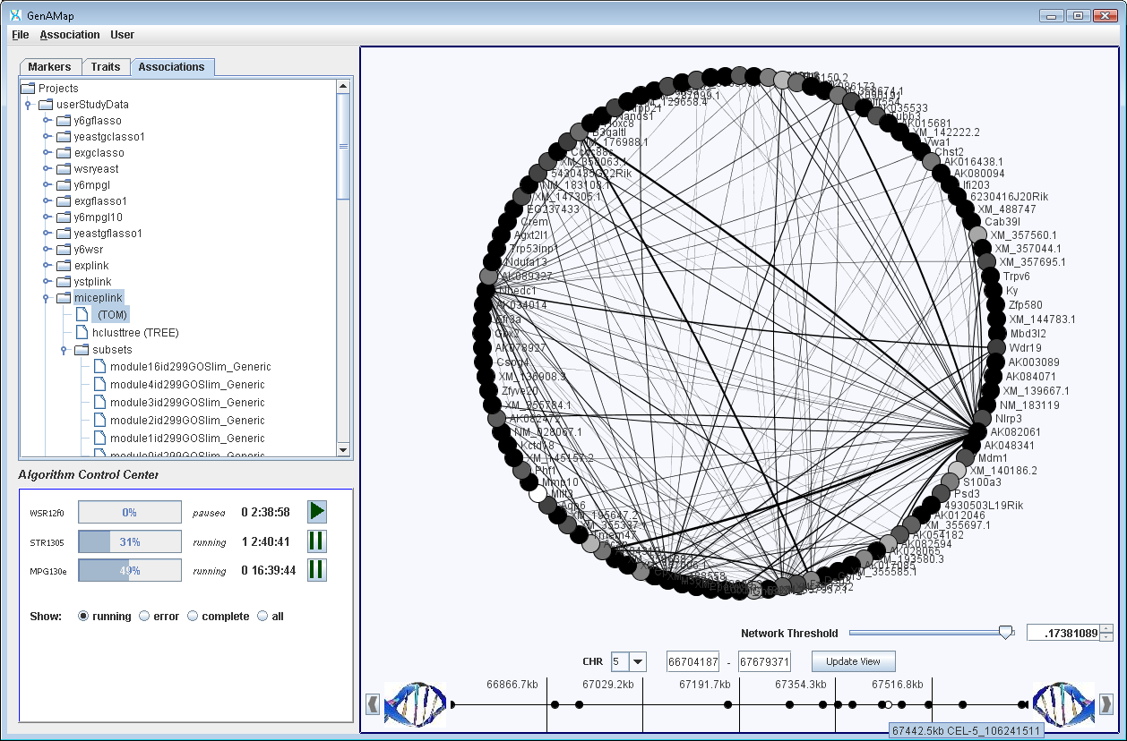
Select region to investigate on chromosome 5

Slide 62
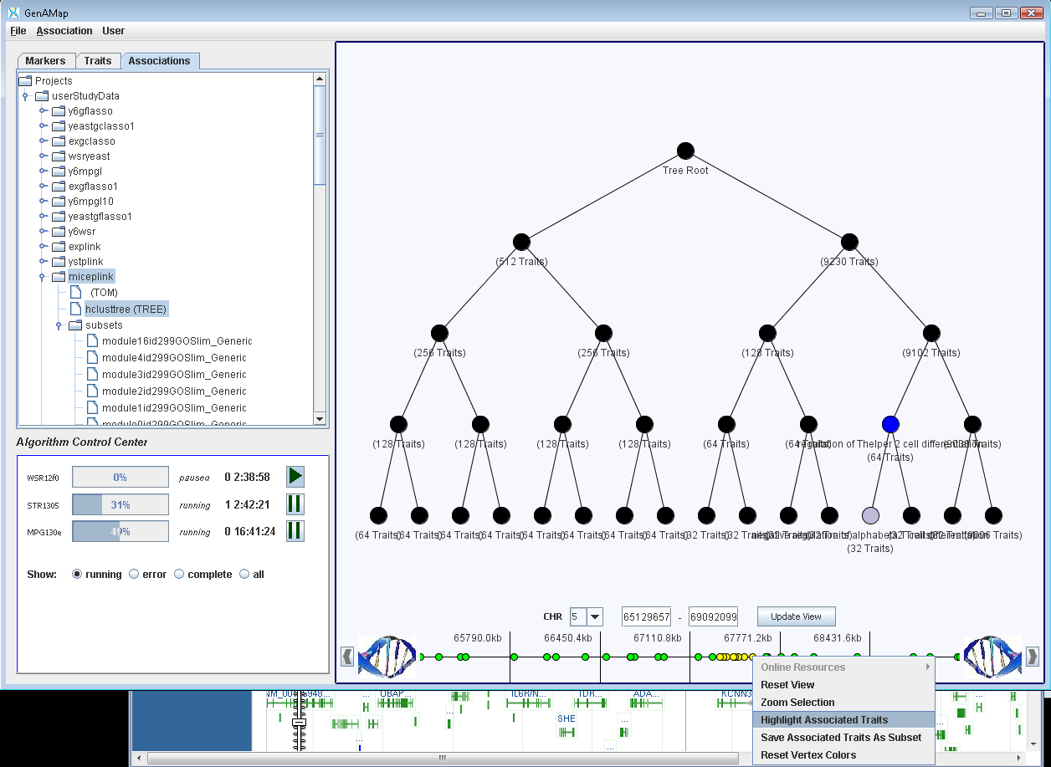
Switch to tree visualization

Slide 63
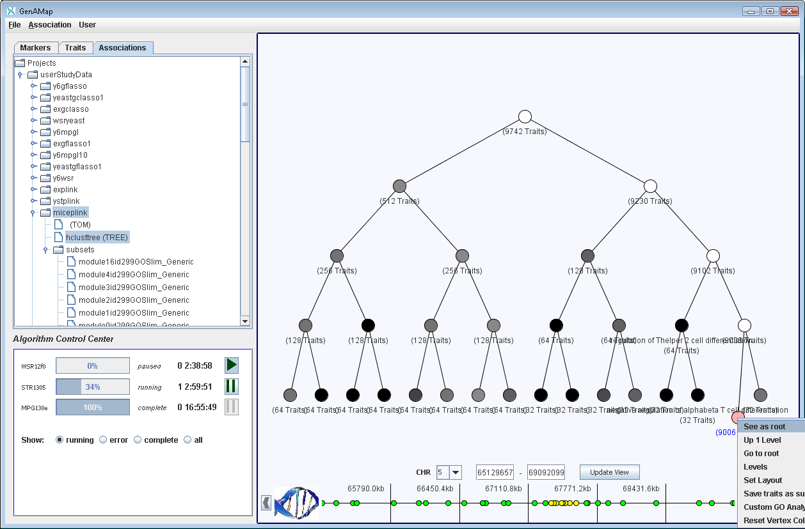
Nodes representing traits with strong associations to the SNPs are colored black, or light gray.

Slide 64
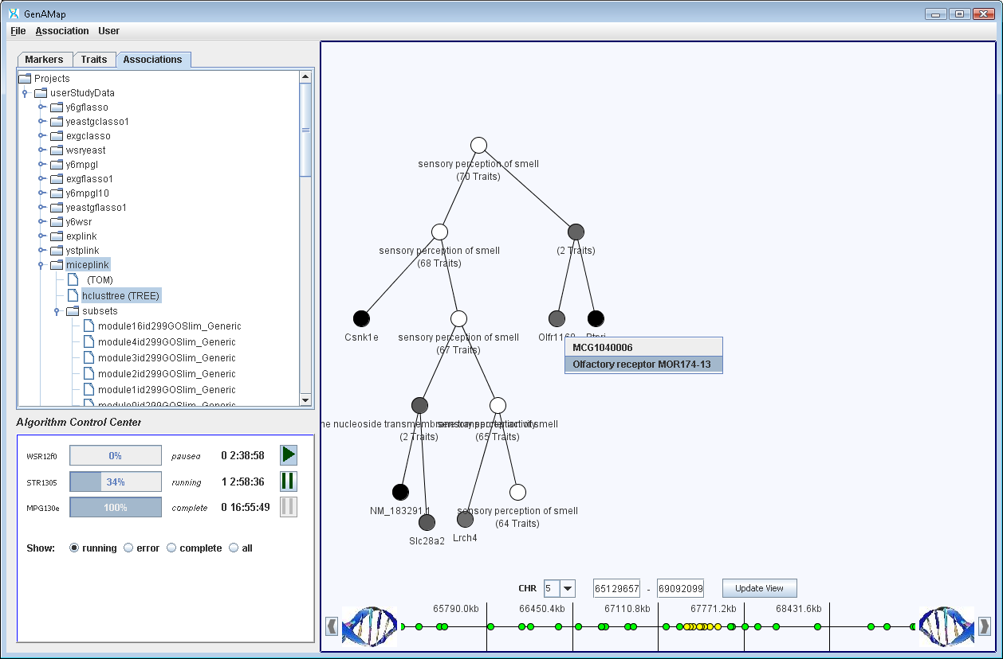
This region is associated with sensory perception of smell

Slide 65
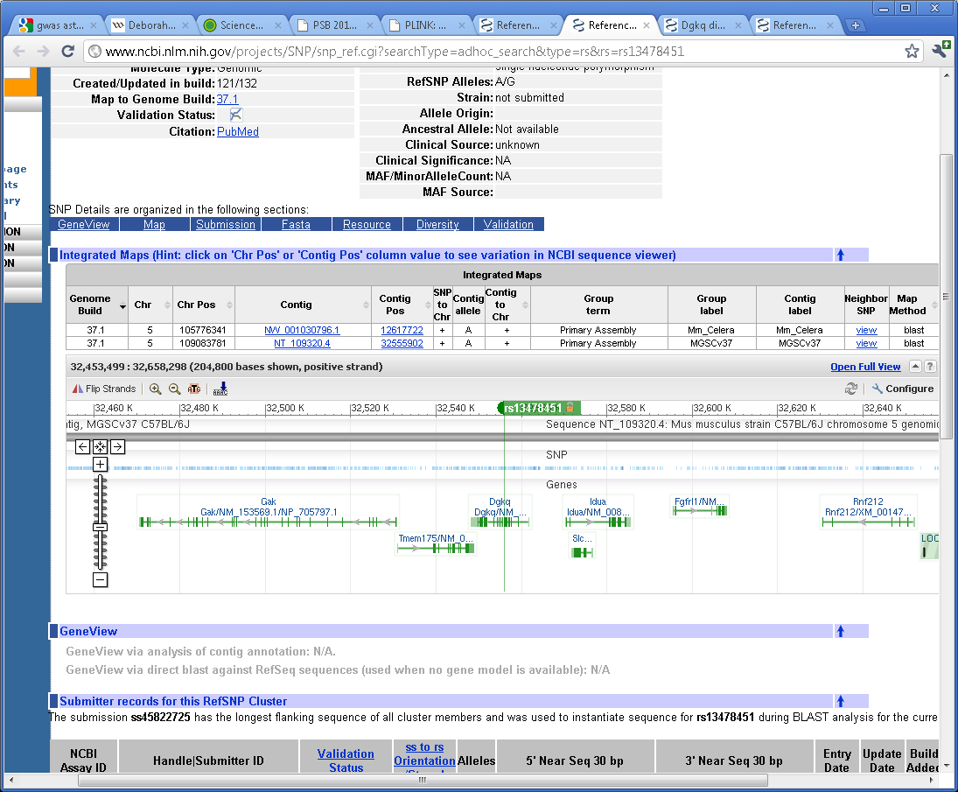
These are our candidate genes near the SNP

Slide 66
Correcting for Multiple Testing
What happens when we scan the genome of 1 million markers for association with α = 0.05?
50,000 (=1 millionx0.05) SNPs are expected to be found significant just by chance
We need to be more conservative when we decide a given marker is significantly associated with the trait.
Correction methods
Bonferroni correction
Permutation test

Slide 67
Bonferroni Correction
If N markers are tested, we correct the significance level as α’= α/N
Assumes the N tests are independent, although this is not true because of the linkage disequilibrium.
Overly conservative for tightly linked markers

Slide 68
Permutation Procedure
Step 1: Compute the test statistic T using the original dataset
Step 2: Set Nsig = 0
Step 3: Repeat 1:Nperm
Step 3a: Randomly permute the individuals in the phenotype data to generate datasets with no association (retain the original genotype)
Step 3b: Find the test statistics Tperm of SNPs using the permuted dataset
Step 3c: if T> Tperm, Nsig = Nsig+1
Step 4: Compute p-value as (1-Nsig/Nperm)
This approach is computationally demanding because often a large N_{perm} is required.

Slide 69
Considering All SNPs in a Single Association Model
Sparse multivariate regression
Estimates the effect of each SNP on the phenotype in the presence of all the other SNPs
High-dimensional data
Association strengths should be estimated for a very large number of SNPs
Penalized regression methods can be used to set the association strengths of many irrelevant SNPs to zero
Estimating the parameters (association strengths)
Convex optimization methods

Slide 70
Multivariate Regression for Single-Trait Association Analysis
Trait
Genotype
Association Strength
2.1
=
x
?
T G A A C C A T G A A G T A
y
=
X
x
β

Slide 71
Multivariate Regression for Single-Trait Association Analysis
Trait
Genotype
Association Strength
2.1
=
x
T G A A C C A T G A A G T A
argmin (y – Xβ) (y – Xβ)
β
Many non-zero associations:
Which SNPs are truly significant?

Slide 72
Sparsity
One common assumption to make is sparsity.
Makes statistical sense: Learning is now feasible in high dimensions with small sample size
Makes biological sense: each phenotype is likely to be associated with a small number of SNPs, rather than all the SNPs.
72
Notes:
One assumption to make is sparsity.
This makes a lot of biological sense since you wouldn’t expect each gene to interact with all other genes, but rather with a small subset.
Statistically, it makes the learning problem feasible in this high dimensional setting, since the solution set is now restricted.
Furthermore it makes the results interpretable. It is much easier to to look at 5 genes that affect another gene instead of 1000.
Laplace Max-margin Markov Networks
72

Slide 73
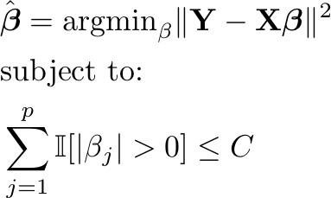
Sparsity: In a mathematical sense
Consider least squares linear regression problem:
Sparsity means most of the beta’s are zero.
But this is not convex!!! Many local optima, computationally intractable.
x₁
β₁
x₂
β₂
β₃
x₃
y
…
β_{n-1}
x_{n-1}
β_{n}
x_{n}
73
Notes:
Consider the least squares problem.
Ideally, we would like to achieve sparsity by simply restricting the number of of regression coefficients that are nonzero.
However, there is a problem. This sparsity constraint is non-convex, meaning optimization is computationally difficult. There are many local optima, and it is likely that optimizing the objective will get stuck in one of them.
Thus we will never get to the global optimum and have to resort to heuristics to avoid local optima. Furthermore the constraint is not-smooth amking optimization more difficult.
Laplace Max-margin Markov Networks
73

Slide 74
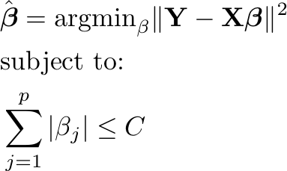
L1 Regularization (LASSO)
A convex relaxation.
Still enforces sparsity!
Constrained Form
Lagrangian Form
74
Notes:
L1 regularized regression (commonly known as the LASSO) is a convex relaxation. Instead of limiting the number of nonzero coefficients, we constrain the absolute values of coefficients.
Although this penalty introduces some bias (it still shrinks relevant coefficients as well as irrelevant ones), it is effective at enforcing sparsity.
Consider the example of the diagram that shows the level sets of an objective function and the feasible set imposed by the L1-penalty. Intuitively, the objective function will be minimized at a corner of the feasible set, resulting in a sparse solution.
Since the problem is convex, an exact solution can be achieved.
Laplace Max-margin Markov Networks
74

Slide 75
Lasso for Reducing False Positives
Trait
Genotype
Association Strength
2.1
=
x
T G A A C C A T G A A G T A
Lasso Penalty for sparsity
argmin (y – Xβ) (y – Xβ)
+
| β_{j} |
β
Many zero associations (sparse results)
Tibshirani, Journal of Royal Statistical Society 1996
Wu et al., Bioinformatics 2009

Slide 76
Estimating Parameters in Lasso (Association Strengths)
Pathwise coordinate descent algorithm
(Friedman et al., Annals of Applied Statistics 2007)
Compute the subgradient of the objective function with respect to each to find the update equation
In each iteration, update each , and iterate until convergence
A fast implementation available at
http://cran.r-project.org/web/packages/glmnet/index.html
β_{j}
β_{j}

Slide 77
Logistic Regression for Multiple SNPs in Case/control Association
Case(1)/Control(0)
Genotype
Individual 1
0
. . C . . . . . T . . C . . . . . . . T . . .
. . C . . . . . A . . C . . . . . . . T . . .
Individual 2
1
. . G . . . . . A . . G . . . . . . . A . . .
. . C . . . . . T . . C . . . . . . . T . . .
…
. . C . . . . . A . . G . . . . . . . T . . .
Individual N
1
. . C . . . . . T . . C . . . . . . . T . . .
f : logistic function
βk : weight (association strength) for the kth SNP
xik : genotype of the kth SNP for the ith individual (0,1, or 2 depending on the number of minor alleles)

Slide 78
Part III
Structured
Genome-Phenome-Transcriptome
Association Analysis

Slide 79
Structured Association: a New Paradigm
Standard Approach
New Approach
Consider multiple correlated phenotypes (phenome) and genotypes (genome) jointly
Consider
one phenotype at a time
vs.
Phenotypes
Phenome

Slide 80
Overview
Genome structure in association analysis
Linkage disequilibrium
Population structure
Epistasis
Transcriptome structure in association analysis
Pleiotropy
Pathway-based statistical tests
Leveraging gene expression network
Leveraging gene expression tree
Phenome structure in association analysis
Pleiotropy
Dynamic trait
Two-way structured association
Three-way structured association
Visualization software
G
T
P
G
T
G
P
T
P
G
T
P

Slide 81
Multi-marker Association Test
Idea: a haplotype of multiple SNPs is a better proxy for a true causal SNP than a single SNP
Exploit the linkage disequilibrium structure in genome
Form a new allele by combining multiple SNPs for a haplotype
Test the haplotype allele for association
SNP A SNP B
0 0
0 1
1 0
1 1
Auxiliary Markers for Haplotypes
1 0 0 0
0 1 0 0
0 0 1 0
0 0 0 1

Slide 82
Multi-marker Association Test
Multi-marker approach can capture dependencies across multiple markers
SNPs in LD form a haplotype that can be tested as a single allele
Can achieve the same power with data collected for fewer samples
Challenge as the size of haplotype increases
Haplotype of K SNPs results in 2^{K} different haplotypes, but the number of samples corresponding to each haplotype decreases quickly as we increase K
Large K requires a large sample size

Slide 83
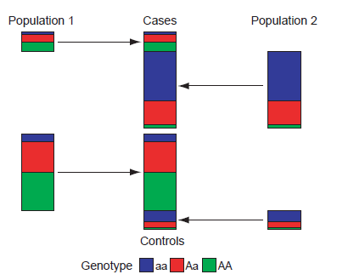
Population Structure and Association Analysis
Population structure in data causes false positives
Samples in the case population are usually more related
Any SNPs more prevalent in the case population will be found significantly associated with the trait.

Slide 84
Accounting for Population Structure in Association Analysis
Needs to account for population structure in association mapping
Genomic control (Devlin & Roeder, Biometrics 1999)
Structured association (Pritchard et al., AJHG 2000)
EigenStrat: principal component analysis (Price et al., Nature Genetics 2006)
Multi-population lasso (Puniyani et al., ISMB 2010)

Slide 85
Genomic Control (GC)
Idea: Use the SNPs that are not associated with the trait to remove the effect of population stratification
Genotype data consist of
Candidate genes to be tested
L supplementary loci (null loci) for estimating the inflation factor λ
GC uses the inflation factor λ to correct the association statistic of the SNP in the candidate gene
Limitation: the inflation factor λ is assumed to be the same across the genome, ignoring population admixture
Devlin & Roeder, Biometrics 1999

Slide 86
Structured Association
Idea: Within each subpopulation, an association between a genetic marker and the trait is a true association.
Two-stage method
Step 1: Using Structure (Pritchard et al., Genetics 2000) and unlinked genetic markers,
estimate the population structure
assign sampled individuals to putative subpopulations
Step 2:
Test for association within the subpopulations inferred in Step 1
Limitation
Running Structure is computationally demanding
Pritchard et al., AJHG 2000

Slide 87
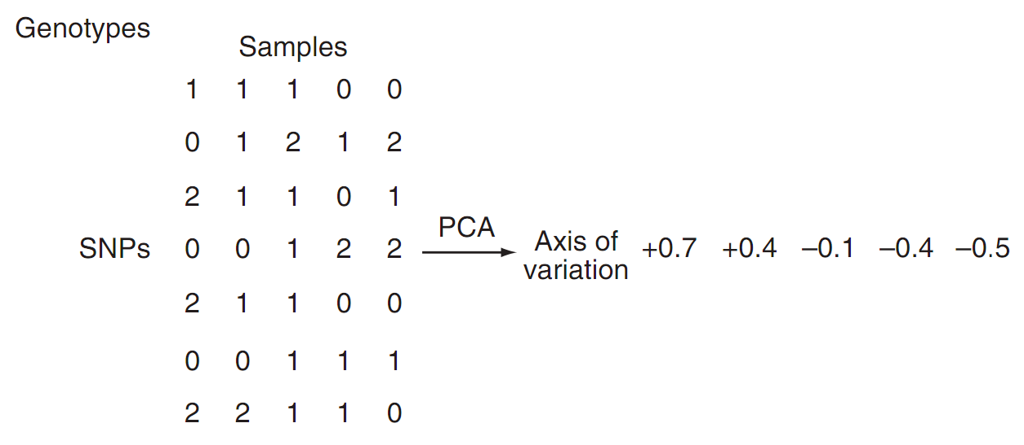
EigenStrat: Structured Association with PCA
Step 1: (Inferring Ancestry) PCA is applied to genotype data to infer continuous axes of genetic variation
Price et al., Nature Genetics 2006

Slide 88
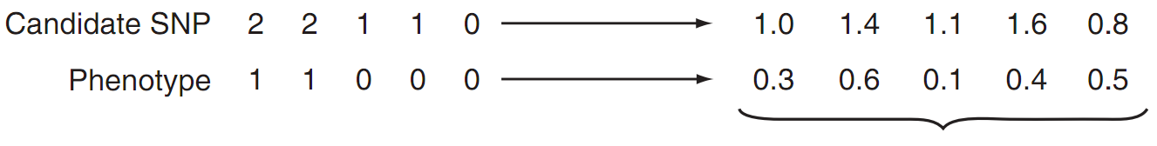
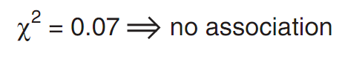
EigenStrat: Structured Association with PCA
Step 2: (Removing Ancestry Effects) Genotype at a candidate SNP and phenotype are continuously adjusted by amounts attributable to ancestry along each axis
Step 3: (Association test)

Slide 89
Multi-Population Group Lasso (MPGL)
Idea: instead of correcting for the population structure (as in GC, structured association, and EigenStrat), let’s exploit the population structure to detect true associations
Assume that the population structure is known
If not, use existing algorithms such as Structure to infer population structure
Sparse multivariate regression with group-lasso penalization
Puniyani et al., ISMB 2010

Slide 90
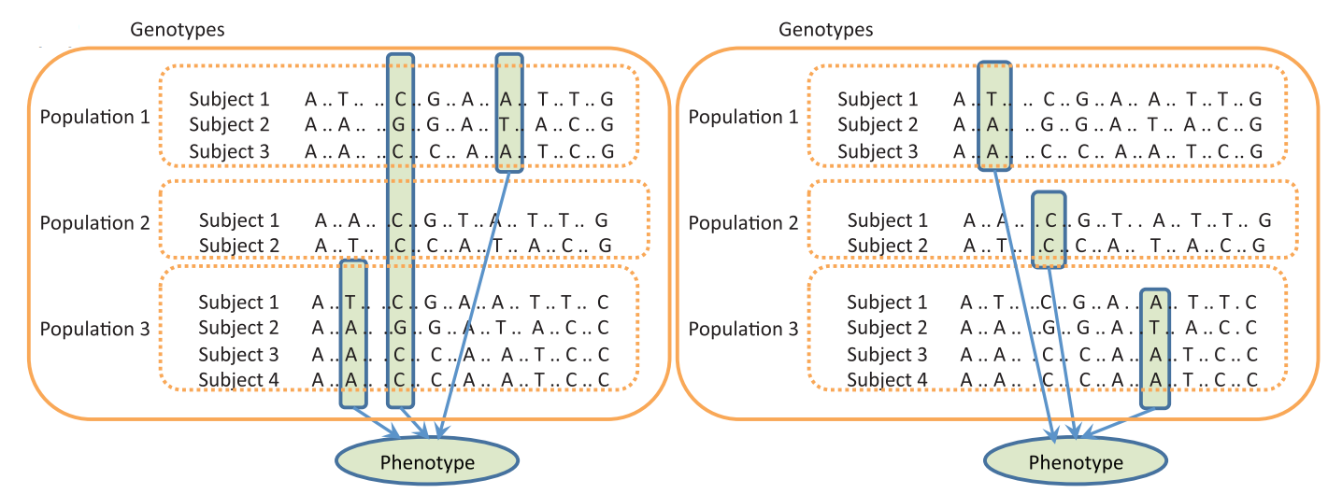
Multi-Population Group Lasso (MPGL)
MPGL combines information across multiple populations to detect
SNPs with associations in all of the populations
SNPs with associations in each population
MPGL
Single-Population lasso applied to each population separately

Slide 91
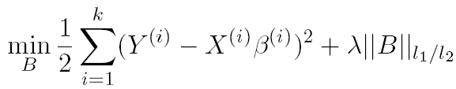
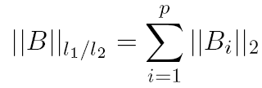
Multi-Population Group Lasso (MPGL)
Joint estimation of shared and population-specific associations
For Each Population i
Least Square Error
Encourages Joint Sparsity
Sum over SNPs

Slide 92
Experiments: Lactose Persistence
Data : 1400 individuals from the control group of the WTCCC dataset, all of European descent. (The Wellcome Trust Case Control Consortium, Nature 2007)
Genotype : 135.16-136.82Mb region on chromosome 2 (known to show geographical variation).
Phenotype : Lactose persistence, fully determined by a particular mutation near the LCT gene (Enattah et al., 2002)
Associated marker : SNP rs4988243 lies in a high linkage disequilibrium region (r² >0.9) with this known genetic variant.

Slide 93
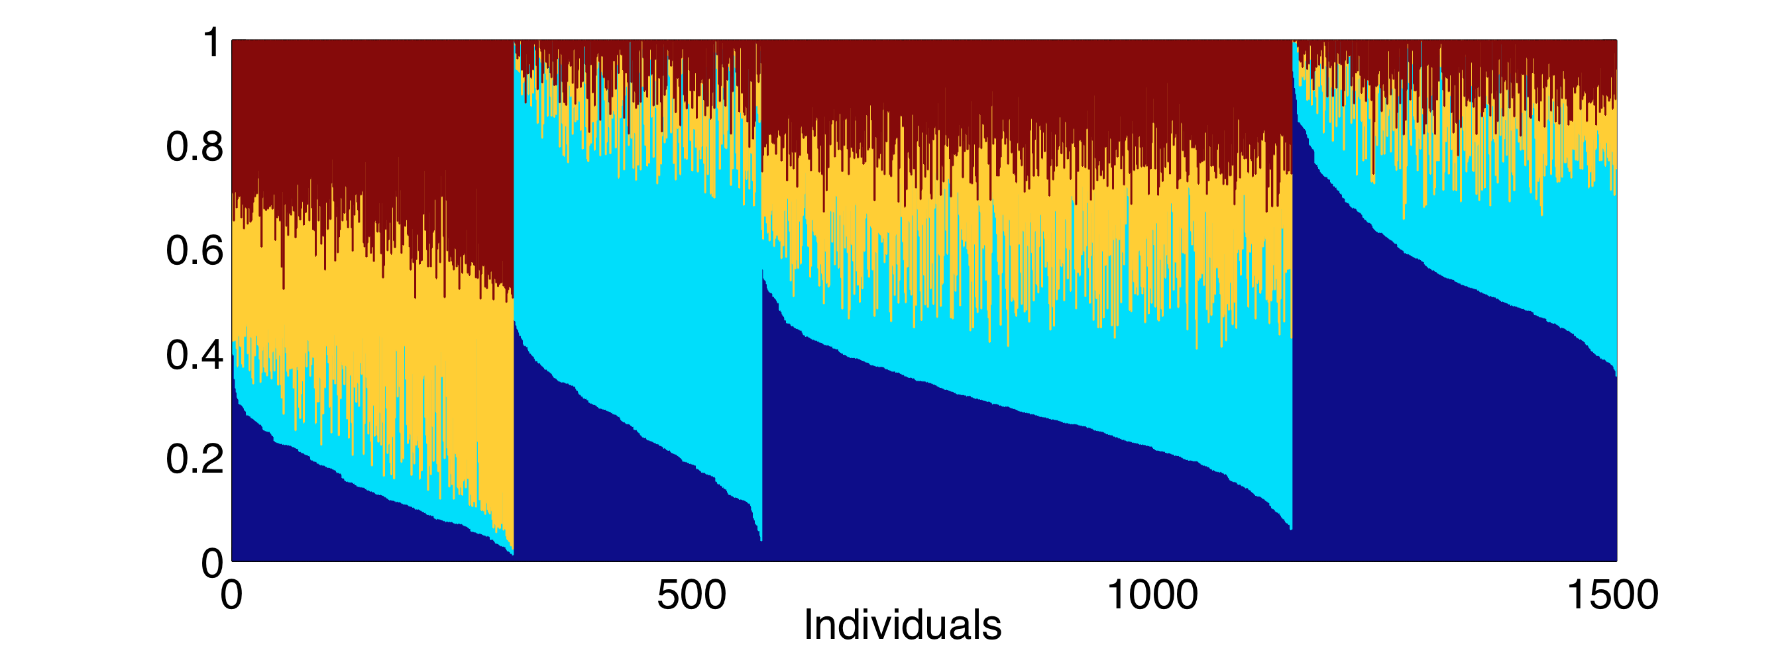
Analysis of Population Structure
Results from Structure (Pritchard et al., Genetics 2000) on genotype data with four populations

Slide 94
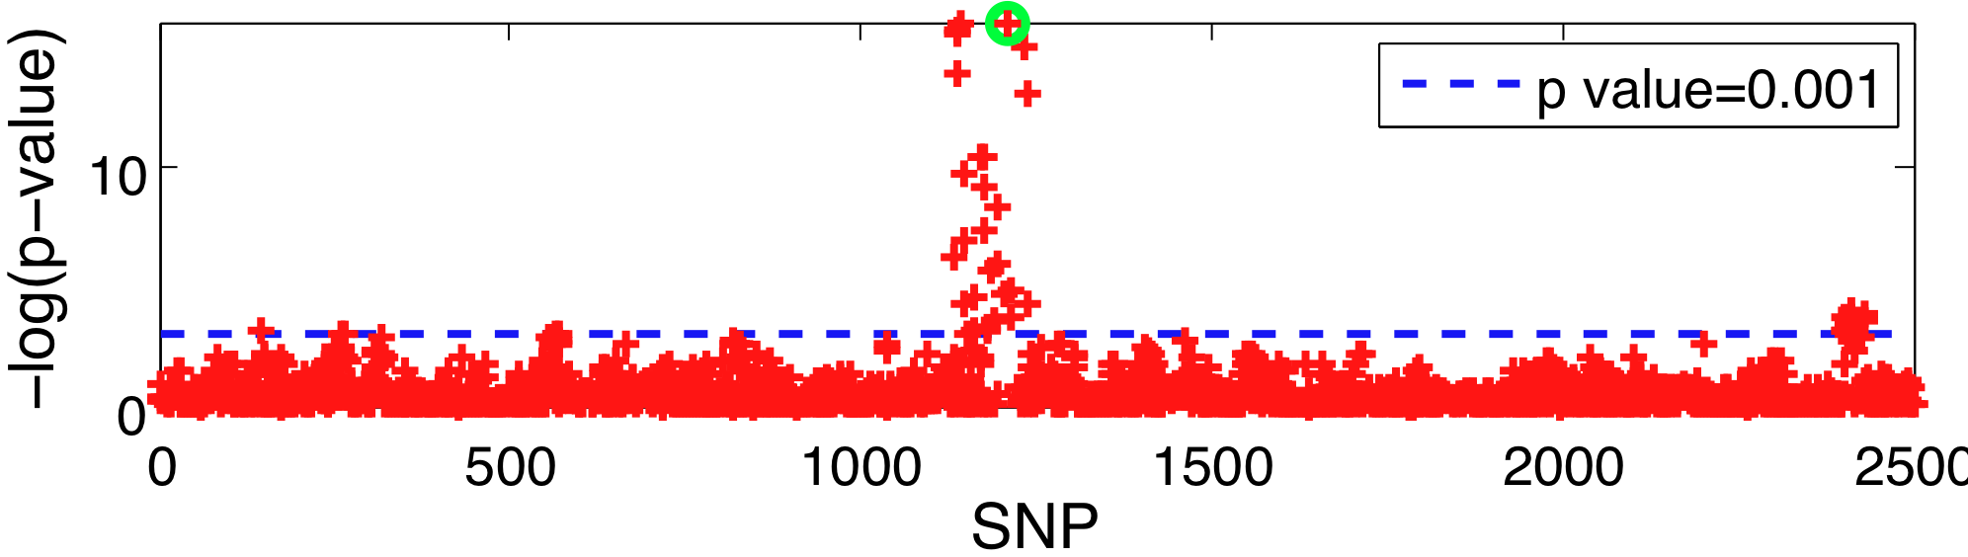
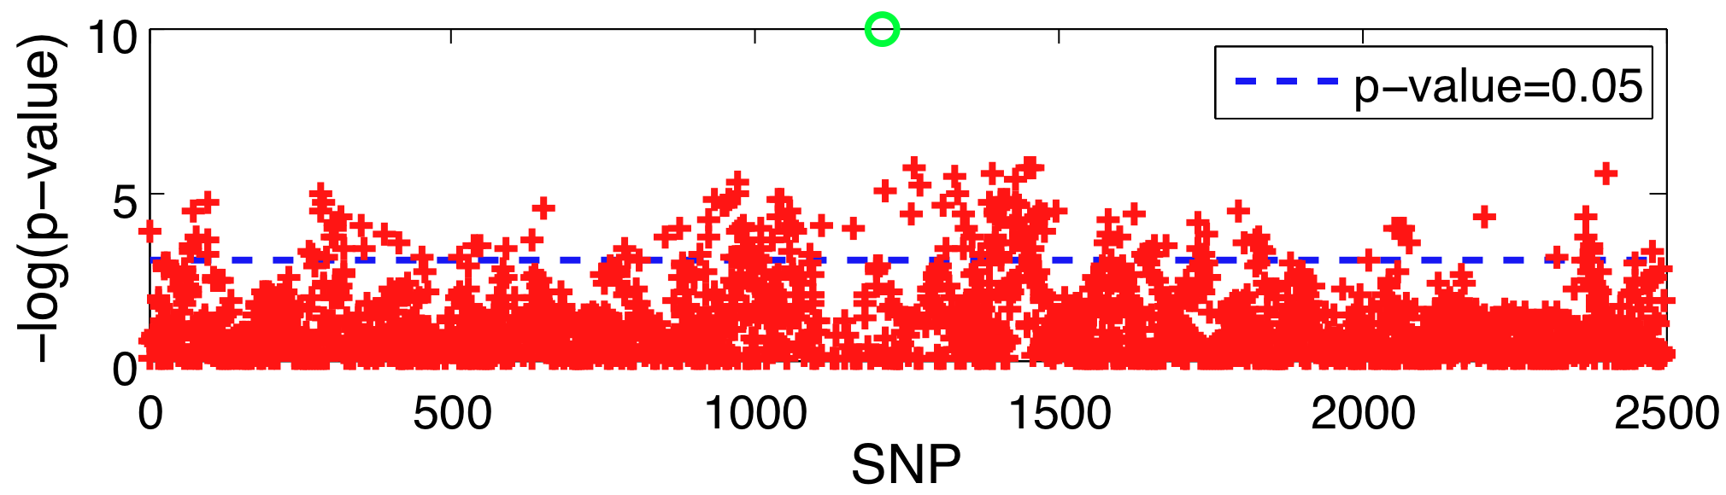

Results
Associated SNP
Eigenstrat
Genomic Control
Lasso

Slide 95


Results
Associated SNP
Lasso for structured association
MPGL identifies only the correct SNP

Slide 96
Association Analysis of Mouse Data: Considering Population Structure
NIH heterogeneous stock of mice (Johannesson et al., Genome Research 2009)
259 mice descended from 7 inbred strains (A/J, AKR/J, BALBc/J, CBA/J, C3H/HeJ, C57BL/6J, DBA/2J and LP/J)
176 phenotype measurements
12,545 SNPs
Specifically look at 7 asthma-related traits
Respiratory rate, tidal volume, minute volume, expiratory time, inspiratory time, enhanced pause

Slide 97

Mouse results from structure – 2 populations

Slide 98

Mouse results from structure – 3 populations

Slide 99

Mouse results from structure – 4 populations

Slide 100

Mouse results from structure – 4 populations

Slide 101

Mouse results from structure – 4 populations

Slide 102

Mouse results from MPGL
Traits are strongly correlated
All four populations are associated to SNP mCV25314100, (next to rs3713033) strongest signal in population #4
link

Slide 103

dbSNP

Slide 104


Slide 105
Epistasis
Definition: The effect of one locus depends on the genotype of another locus

Slide 106

Epistasis for Mendelian Traits
Carlborg & Haley, Nature Reviews Genetics 2004

Slide 107




Epistasis for Complex Traits
Carlborg & Haley, Nature Reviews Genetics 2004

Slide 108
Epistasis
Epistatic effects of SNPs can often be detected only if the interacting SNPs are considered jointly
The number of candidate SNP interactions is very large
For J SNPs, JxJ SNP pairs need to be considered for epistasis
In general for J SNPs and K-way interactions, there are O(J^{K}) candidate interactions
Computationally expensive to consider all possible groups of interacting SNPs
For a reliable detection of K-way interactions, a large sample size is required
Multiple testing problem

Slide 109
Two-stage Lasso for Detecting Epistasis (Wu et al. Genetic Epidemiology 2010)
Two-stage lasso
Stage 1: Apply lasso with no consideration of epistasis to detect SNPs with significant individual effects
Stage 2: Apply lasso with pairs of only those SNPs selected in Stage 1
Reduces the computational burden
Limitation: SNPs with epistatic effects often do not have detectable individual (marginal) effects, and many of these association signals will be missed.

Slide 110

Epistasis: Exploiting Prior Knowledge
Synthetic genetic interaction network from double-knockout experiments provide strong evidence of gene-gene interaction
Idea I: Use the synthetic genetic interaction network to generate candidate SNP pairs with epistatic interaction
Costanzo et al., Science 2010

Slide 111

Epistasis: Exploiting Prior Knowledge
Synthetic genetic interaction network from double-knockout experiments provide strong evidence of gene-gene interaction
Idea II: Combine information across related candidate SNP pairs to increase the power of detecting associations
Costanzo et al., Science 2010

Slide 112
Epistasis: Exploiting Prior Knowledge
Idea I: Use the synthetic genetic interaction network to generate candidate SNP pairs with epistatic interaction
Idea II: Combine information across related candidate SNP pairs to increase the power of detecting associations

Slide 113
Epistasis: Structured Input/Ouput (IO)-Lasso
Idea I: Use the synthetic genetic interaction network to generate candidate SNP pairs with epistatic interaction
Idea II: Combine information across related candidate SNP pairs to increase the power of detecting associations
Lee, Kim, & Xing, Submitted 2011

Slide 114
Results on Yeast eQTL Dataset
Yeast eQTL dataset (Brem & Kruglyak, PNAS 2005)
Genotypes: 114 yeast strains from the cross of laboratory strains and wild strains, 1260 non-redundant SNPs
Phenotypes: gene-expression levels for 5,637 genes
2,219 clusters of the traits
Yeast genetic interactions (Costanzo et al., Science 2010)
Yeast contains ~6,000 genes
Synthetic genetic interactions for 5.4 million gene-gene pairs
We extracted 73,720 significant SNP pairs based on the results from synthetic lethal interaction experiment (0.09% of all SNP pairs)
We further selected 9,388 representative SNP pairs from these pairs of SNPs so that the correlation among the selected SNPs is low

Slide 115
eQTL hotspots of individual SNP effects
Red lines:
Previously reported eQTL hotspots [Yvert et al. 2003]
eQTL hotspots of epistatically interacting SNPs
Lee, Kim, & Xing, Submitted 2011

Slide 116
Top 20 Epistatic Hotspots
Lee, Kim, & Xing, Submitted 2011

Slide 117
Overview
Genome structure in association analysis
Linkage disequilibrium
Population structure
Epistasis
Transcriptome structure in association analysis
Pleiotropy
Pathway-based statistical tests
Leveraging gene expression network
Leveraging gene expression tree
Phenome structure in association analysis
Pleiotropy
Dynamic trait
Two-way structured association
Three-way structured association
Visualization software
G
T
P
G
T
G
P
T
P
G
T
P

Slide 118
Association to the Transcriptome
Expression quantitative trait locus (eQTL) analysis
Gene expression traits as phenotypes in association analysis
Typically involves more than 5000 genes
Univariate regression analysis and lasso could be applied to each gene expression trait
Pleiotropic effects of SNPs
Definition: A genetic variation influences multiple phenotypes jointly
Instead of assessing the effect of genotype on a single phenotype, we consider multiple related phenotypes (e.g., genes in the same pathway) to detect pleiotropic effects

Slide 119

Computational Methods for Detecting Pleiotropy
Method 1: Aggregating the results from a set of single-gene (trait) analyses
Limitation: It does not directly search for pleiotropic effects, but looks for pleiotropy as a post-processing step after single-trait analyses

Slide 120


Yeast eQTL Analysis: Association to a Gene Module
Yeast eQTL dataset
Genotypes from 112 segregants from a yeast cross between BY and RM strains
Microarray gene-expression data
Zhu et al., Nature Genetics 2008

Slide 121

Computational Methods for Detecting Pleiotropy
Method 2: Lirnet finds SNPs associated with average over phenotypes in each module
Joint estimation of
Regulatory modules
SNPs associated with each regulatory module
Regulatory potentials for the importance weights of prior knowledge on SNPs
Limitation: Lirnet uses averaged phenotypes rather than the raw phenotype values
Loss of information
What about anti-correlated phenotypes?
Lee et al., PLoS Genetics 2009

Slide 122
Computational Methods for Detecting Pleiotropy
Method 3: Apply PCA to phenotype data and perform association analysis on the projected phenotype data (Weller et al., Theo. Appl. Gen. 1996, Mangin et al., Biometrics 1998)
Limitation: It is not obvious how to interpret the projected phenotype values and their associations to genotypes

Slide 123
Computational Methods for Detecting Pleiotropy
Method 4: Structured multi-task sparse regression that incorporate transcriptome structure as prior knowledge
Graph-guided fused lasso: gene-gene interaction as graph (Kim & Xing, PLoS Genetics 2009)
Tree-guided group lasso: gene modules as hierarchical clustering tree (Kim & Xing, ICML 2010)
Extending generic toolbox in statistics for association analysis
Convex optimization (Boyd and Vandenberghe, Cambridge University Press 2004)
Fast computation for complex algorithms
Penalized regression method for structured sparsity
Increase the power of detecting associations
Notes:
yes

Slide 124
Structured Association
Traditional Approach
Association with Phenome
causal SNP
ACGTTTTACTGTACAATT
ACGTTTTACTGTACAATT
a univariate phenotype:
gene expression level
Multivariate complex syndrome (e.g., asthma)
age at onset, history of eczema
genome-wide expression profile
Greater power
Fewer false positives
Phenome associations

Slide 125
Regression for Single-Trait Association Analysis
Trait
Genotype
Association Strength
2.1
=
x
T G A A C C A T G A A G T A
argmin (y – Xβ) (y – Xβ)
β
Many non-zero associations:
Which SNPs are truly significant?

Slide 126
Lasso for Reducing False Positives
Trait
Genotype
Association Strength
2.1
=
x
T G A A C C A T G A A G T A
Lasso Penalty for sparsity
argmin (y – Xβ) (y – Xβ)
+
| β_{j} |
β
Many zero associations (sparse results), but what if there are multiple related traits?
Tibshirani, Journal of Royal Statistical Society 1996
Wu et al., Bioinformatics 2009

Slide 127
Multi-Task Regression for Transcriptome Association Analysis
Expression Levels
Genotype
Association Strength
Association strength between
SNP j and Trait k: β_{jk}
(3.4, 1.5, 2.1, 0.9, 1.8)
=
x
Ribi genes
Telomere maintenance genes
T G A A C C A T G A A G T A
?
argmin (y – Xβ) (y – Xβ)
+
| β_{j} |
β
How to combine information across multiple traits to increase the power?

Slide 128
Multi-Task Regression for Transcriptome Association Analysis
Expression Levels
Genotype
Association Strength
Association strength between
SNP j and Trait k: β_{jk}
(3.4, 1.5, 2.1, 0.9, 1.8)
=
x
Ribi genes
Telomere maintenance genes
T G A A C C A T G A A G T A
argmin (y – Xβ) (y – Xβ)
+
| β_{j} |
β
We introduce
graph-guided fusion penalty
+
Kim & Xing, PloS Genetics 2009
Notes:
yes

Slide 129

Graph-Constrained Fused Lasso
Step 1: Thresholded correlation graph for gene interactions
Step 2: Graph-constrained fused lasso
ACGTTTTACTGTACAATT
Fusion
Lasso Penalty
Graph-constrained fusion penalty
Kim & Xing, PloS Genetics 2009

Slide 130
Fusion Penalty
Fusion Penalty: | β_{jk} - β_{jm} |
For two correlated traits (connected in the network), the association strengths may have similar values.
SNP j
ACGTTTTACTGTACAATT
Association strength between SNP j and Trait k: β_{jk}
Association strength between SNP j and Trait m: β_{jm}
Trait m
Trait k
Kim & Xing, PloS Genetics 2009

Slide 131
Transcriptome Association: Graph-Constrained Fused Lasso
Fusion effect propagates to the entire network
Association between SNPs and subnetworks of traits
Overall effect
ACGTTTTACTGTACAATT
Kim & Xing, PloS Genetics 2009

Slide 132
Transcriptome Association: Graph-Weighted Fused Lasso
Subnetwork structure is embedded as a densely connected nodes with large edge weights
Edges with small weights are effectively ignored
Overall effect
ACGTTTTACTGTACAATT
Kim & Xing, PloS Genetics 2009

Slide 133

Estimating Parameters
Quadratic programming formulation
Important properties:
Convex optimization --- therefore global optimum exist
Sparse --- therefore results are parsimonious and interpretable
Theoretical Guarantee --- proof of consistency exist
Many publicly available software packages for solving convex optimization problems can be used
A new proximal gradient method can handle tens of thousands of SNPs and thousands of traits (later)

Slide 134


Simulation Results

Slide 135
Yeast eQTL Dataset (Brem and Kruglyak, PNAS 2005)
Genotype: 1260 SNPs
Phenotype: expression measurements for 3684 genes
114 strains
Goal: are there any SNPs that influence expression levels of genes?
Scale-free network construction and module finding
GFlasso analysis to find associations

Slide 136

Gene-gene network exploration
The network is sorted by hierarchical clustering
“Modules” are highly connected groups of genes and are found and outlined in the network.

Slide 137

Gene-gene network exploration : Mitochondrion module
N: # total genes
X: # module genes
n: # genes in GO category
x: # overlap

Slide 138

Gene-gene network exploration: ribosome biogenesis module

Slide 139

Gene-gene network exploration: zoom into mitochondrion module

Slide 140


Slide 141

Gene-gene network exploration: GO analysis

Slide 142


Slide 143

Gene-gene network exploration: Identify hubs

Slide 144

Gene-gene network exploration: UniProt information

Slide 145

GFlasso association results
An overview of association results are presented as a heat map.
Genes are clustered.

Slide 146
GFlasso results
Interacting eQTL hotspots
Interacting eQTL hotspots
eQTL hotspot

Slide 147

Comparing results with wilcoxon-sum-rank test (single SNP/gene analysis)
GFlasso results are more sparse and structured
No interacting eQTL hotspots
GFLasso has greater power:
More eQTL hotspots with potential interactions among them
Notes:
yes

Slide 148
Investigate an eQTL hotspot associated with a single locus

Slide 149

GO analysis reveals hotspot is enriched for ribosome genes

Slide 150

Associations on chromosome 2

Slide 151

Look at association strengths to highest connected genes

Slide 152

Only a few genes are associated with the hotspot around this SNP (not black), but the highest connected genes are associated with this hotspot.

Slide 153


Slide 154

SNP in RPB5 – causal or linked?

Slide 155
Investigate interacting eQTL hotspots

Slide 156

Genes are enriched for ribosome biogenesis and are associated with these SNPs on chromosome 5.

Slide 157

DOT6 (also known as PBF2) is located in cis with these SNPs

Slide 158


Slide 159

Genes are also associated with these SNPs on chromosome 2.

Slide 160

Candidate regulators on chromosome 2.

Slide 161

Genes are also associated with these SNPs on chromosome 7.

Slide 162

Candidate regulators on chromosome 7

Slide 163

Could KAP114 also import Ribi genes?

Slide 164

Investigate interacting eQTL hotspots

Slide 165


Slide 166

Two SNPs on chromosome 12 are associated with these genes.
link
link

Slide 167

NUP2

Slide 168


Slide 169

SIR3 / RIF2

Slide 170


Slide 171

Summary
Exploiting transcriptome structure in association analysis
Pleiotropy
Pathway-based statistical tests
Leveraging gene expression network
Structured association – a new paradigm
Association to a graph-structured transcriptome
Graph-guided fused lasso (Kim & Xing, PLoS Genetics, 2009)
More structures (next)
Leveraging gene expression hierarchical cluster
Association to a tree-structured transcriptome
Tree-guided group lasso (Kim & Xing, ICML 2010)

Slide 172

Gene Expression Trait Analysis
TCGACGTTTTACTGTACAATT
Samples
Genes
Statistical challenge
How to find
associations to a multivariate entity
in a tree?

Slide 173
Tree-Guided Group Lasso
TCGACGTTTTACTGTACAATT
Why tree?
Tree represents a clustering structure
Scalability to a very large number of phenotypes
Graph : O(|V|²) edges
Tree : O(|V|) edges
Expression quantitative trait mapping (eQTL)
Agglomerative hierarchical clustering is a popular tool
Kim & Xing, ICML 2010

Slide 174



Tree-Guided Group Lasso
In a simple case of two genes
h
h
Low height
Tight correlation
Joint selection
Large height
Weak correlation
Separate selection
Genotypes
Genotypes

Slide 175




Tree-Guided Group Lasso
In a simple case of two genes
Select the child nodes jointly or separately?
h
Tree-guided group lasso
L₁ penalty
Lasso penalty
Separate selection
L₂ penalty
Group lasso
Joint selection
Similar to elastic net (Zou & Hastie, J. R. Statist. Soc. 2005)

Slide 176




Tree-Guided Group Lasso
For a general tree
h₂
Select the child nodes jointly or separately?
h₁
Tree-guided group lasso
Joint selection
Separate selection

Slide 177

Tree-Guided Group Lasso
For a general tree
h₂
Select the child nodes jointly or separately?
h₁
Tree-guided group lasso
Joint selection
Separate selection

Slide 178
Estimating Parameters
Second-order cone program
Many publicly available software packages for solving convex optimization problems can be used

Slide 179




Yeast eQTL Analysis
Hierarchical clustering tree
Phenotypes
SNPs
High association
No association
Single-Marker Single-Trait Test
Tree-guided group lasso
Lasso

Slide 180
Summary
Exploiting transcriptome structure in association analysis
Pleiotropy
Pathway-based statistical tests
Leveraging gene expression network
Association to a graph-structured transcriptome
using graph-guided fused lasso
Leveraging gene expression hierarchical cluster
Association to a tree-structured transcriptome
using tree-guided group lasso

Slide 181

Summary: why care about structure?
Theoretically, it increase the power [Mladen and Xing, 2010]

Slide 182
Summary: why care about structure?
Method | Power (multi-trait) | FDR
GFlasso | 0.889 | 0.009
plink | 0.803 | 0.014
Sum-rank | 0.748 | 0.008
Screen & Clean | 0.780 | 0.153
Lasso | 0.991 | 0.886
Forward Selection | 0.931 | 0.867
182
Incorporating more information leads to enhanced discovery and lower false discovery (results from simulation test)
If our underlying model is correct!

Slide 183
Improving Scalability of Structured Genome-Transcriptome-Phenome Association Methods
Common challenges in optimization
Tree-guided group lasso, GFlasso, temporally-smoothed lasso
Non-smooth penalty
Non-separability
Coordinate descent algorithm (Friedman et al., Annals of Applied Statistics 2007) cannot be applied.
Proximal-gradient method (Xi et al., submitted)
Step 1: Introduce a smooth approximation to the non-smooth penalty
Step 2: Apply accelerated gradient method

Slide 184







Proximal Gradient Descent
Original Problem:
Approximation Problem:
Gradient of the
Approximation:

Slide 185










Geometric Interpretation
Smooth approximation
Uppermost Line
Nonsmooth
Uppermost Line
Smooth

Slide 186



Convergence Rate
Theorem: If we require and set , the
number of iterations is upper bounded by:
Remarks: state of the art IPM method for for SOCP converges at a rate

Slide 187



Multi-Task Time Complexity
Pre-compute:
Per-iteration Complexity (computing gradient)
Tree:
IPM for SOCP
Proximal-Gradient
Graph:
IPM for SOCP
Proximal-Gradient
Proximal-Gradient: Independent of Sample Size
Linear in #.of Traits

Slide 188







Experiments
Multi-task Graph Structured Sparse Learning (GFlasso)

Slide 189










Experiments
Multi-task Tree-Structured Sparse Learning (TreeLasso)

Slide 190
Overview
Genome structure in association analysis
Linkage disequilibrium
Population structure
Epistasis
Transcriptome structure in association analysis
Pleiotropy
Pathway-based statistical tests
Leveraging gene expression network
Leveraging gene expression tree
Phenome structure in association analysis
Pleiotropy
Dynamic trait
Two-way structured association
Three-way structured association
Visualization software
G
T
P
G
T
G
P
T
P
G
T
P

Slide 191
Association to Phenome
Pleiotropy: a genetic locus influencing multiple different phenotypes
Methods for transcriptome association can be applied
Graph-guided fused lasso (Kim & Xing, PLoS Genetics 2009)
Tree-guided fused lasso (Kim & Xing, ICML 2010)

Slide 192

TCGACGTTTTACTGTACAATT
Genetic Association for Asthma Clinical Traits
Subnetworks for lung physiology

Slide 193
Dynamic-Trait Association Mapping
Dynamic trait with a temporal trend
Growth of tumor over time
Height, weight over time
Gene expressions over time in cell cycle or embryonic development
Are there underlying genetic variants that influence the overall trend over time?

Slide 194
Dynamic Trait (d-trait) Association
Stationary Trait Association
Dynamic Trait Association
Stationary Trait
Dynamic Trait
(e.g., drug response)
t = 1
t = 2
t = 3
t = T
Association Strengths
Association Strengths
A T C G A T T C C A T A
A T C G A T T C C A T A
Genotypes
Genotypes
Genetic effects active over time with possibly varying effect size over time
One-time genetic effect

Slide 195

Genetic Control of Growth Trajectories
Wu & Lin, Nature Review Genetics 2006

Slide 196
Temporally-Smoothed Lasso
Step 1: Autoregressive Model
Captures the shape of the temporal trend in the d-trait data
Estimates the model parameters based on the d-trait data only
Step 2: Temporally-Smoothed Lasso
Penalized regression framework
Incorporates the estimated d-trait shape parameters from Step 1
Detects time-varying genetic effects on the d-trait
Kim et al., submitted

Slide 197


Step 1: Autoregressive Model
Autoregressive Model :
Estimating Model Parameters:
Estimates of the Model Parameters:

Slide 198
Step 2: Temporally-Smoothed Lasso
Autoregressive parameters from Step 1
Lasso Penalty
Temporally-smoothed Lasso Penalty

Slide 199

Estimating Association Strengths
Quadratic programming
Convex optimization: many publicly available software packages can be used.
Proximal gradient algorithm can be applied

Slide 200
Proximal Gradient Descent
Original Problem:
Approximation Problem:
Gradient of the
Approximation:

Slide 201
Simulation Study
Genotype:
HapMap-simulated data (The international HapMap Consortium, Nature 2005)
50 SNPs
D-trait:
Linear dynamic
Cyclic dynamic
10 time points
150 individuals

Slide 202




Simulation Study – Linear Dynamic
Trait data for all individuals
Trait data for individuals with
no association SNPs
Trait data for individuals with
1-2 association SNPs
Trait data for individuals with
>3 association SNPs
True association strength
Estimated
association strength (single SNP analysis)
Estimated
association strength (lasso)
Estimated
association strength (temporally-smoothed lasso)

Slide 203




Simulation Study – Cyclic Dynamic
Trait data for all individuals
Trait data for individuals with
no association SNPs
Trait data for individuals with
1-2 association SNPs
Trait data for individuals with
>3 association SNPs
True association strength
Estimated
association strength (single SNP analysis)
Estimated
association strength (lasso)
Estimated
association strength (temporally-smoothed lasso)

Slide 204
Overview
Genome structure in association analysis
Linkage disequilibrium
Population structure
Epistasis
Transcriptome structure in association analysis
Pleiotropy
Pathway-based statistical tests
Leveraging gene expression network
Leveraging gene expression tree
Phenome structure in association analysis
Pleiotropy
Dynamic trait
Two-way structured association
Three-way structured association
Visualization software
G
T
P
G
T
G
P
T
P
G
T
P

Slide 205
Structured Association
Genome Structure
Phenome Structure

Slide 206




Structured Association
Genome Structure
Phenome Structure
Linkage Disequilibrium
Graph
Stochastic block regression
(Kim & Xing, UAI, 2008)
Graph-guided fused lasso
(Kim & Xing, PLoS Genetics, 2009)
Population Structure
Tree
Multi-population group lasso
(Puniyani, Kim, Xing, ISMB, 2010)
Tree-guided fused lasso
(Kim & Xing, ICML 2010)
Epistasis
Dynamic Trait
ACGTTTTACTGTACAATT
Group lasso with networks
(Lee, Kim, Xing, Submitted)
Temporally smoothed lasso
(Kim, Howrylak, Xing, Submitted)

Slide 207
Structured Association
Genome Structure
Phenome Structure
Linkage Disequilibrium
Graph
Stochastic block regression
(Kim & Xing, UAI, 2008)
Graph-guided fused lasso
(Kim & Xing, PLoS Genetics, 2009)
Population Structure
Tree
Multi-population group lasso
(Puniyani, Kim, Xing, ISMB, 2010)
Tree-guided fused lasso
(Kim & Xing, ICML 2010)
Epistasis
Dynamic Trait
ACGTTTTACTGTACAATT
Sparse regularized regression
Convex Optimization
Group lasso with networks
(Lee, Kim, Xing, Submitted)
Temporally smoothed lasso
(Kim, Howrylak, Xing, Submitted)

Slide 208
Structured Genome-Transcriptome-Phenome Association Analysis
Genome Structure
Three-way Association!
Phenome Structure
Epistasis
Population structure
Incorporating prior knowledge
Dynamic trait analysis
Transcriptome Structure
Exploiting gene-interaction network
Exploiting a hierarchical clustering tree of genes
Temporal modeling across time
Notes:
Add slides here. Why we need structure

Slide 209
Summary: why care about structure?
Theoretically, it increase the power [Mladen and Xing, 2010]

Slide 210
Summary: why care about structure?
Method | Power (multi-trait) | FDR
GFlasso | 0.889 | 0.009
plink | 0.803 | 0.014
Sum-rank | 0.748 | 0.008
Screen & Clean | 0.780 | 0.153
Lasso | 0.991 | 0.886
Forward Selection | 0.931 | 0.867
210
Incorporating more information leads to enhanced discovery and lower false discovery (results from simulation test)
If our underlying model is correct!

Slide 211
Overview
Genome structure in association analysis
Linkage disequilibrium
Population structure
Epistasis
Transcriptome structure in association analysis
Pleiotropy
Pathway-based statistical tests
Leveraging gene expression network
Leveraging gene expression tree
Phenome structure in association analysis
Pleiotropy
Dynamic trait
Two-way structured association
Three-way structured association
Visualization software
G
T
P
G
T
G
P
T
P
G
T
P

Slide 212


Visualization Softwares for Association Mapping
GoldSurfer2 http://www.well.ox.ac.uk/gs2
GoldenHelix http://www.goldenhelix.com/
GWAS GUI http://www.sph.umich.edu/csg/weich/browser/
MAVEN http://cbc.case.edu/maven/home.do
Association Viewer http://www.improvedoutcomes.com/docs/WebSiteDocs/Plots/Classification_and_Prediction/SLAM_Assocation_Viewer.htm
eQTLexplorer http://web.bioinformatics.ic.ac.uk/eqtlexplorer/
eQTL Viewer http://statgen.ncsu.edu/eQTLViewer/svgHome.html

Slide 213



GoldSurfer2
Developed by Glaxo SmithKline and Oxford University
Features
Explore genome LD structure
Standard statistical tests for association
Disadvantages
Runs locally

Slide 214




Golden Helix
Features
Standard conventional association tests
Links to external data sources
Fast computation and storage
Data management
Quality assurance
Disadvantages
Case/control methodology

Slide 215

GWAS GUI
Developed by Center for Statistical Genetics, U of Michigan
Features
Manages huge datasets –
including large gene expression
datasets
Results in a graph or tabular form
Searching based on trait or locus
Disadvantages
Must import your own association results
Cannot view structure in the gene expression
Limited visualizations

Slide 216

MAVEN and AssociationViewer
Similar to GWAS GUI, but only for case/control studies
Maven links to external databases
AssociationViewer has advanced memory management capability.

Slide 217


eQTL Explorer and eQTL Viewer
Features – can explore eQTL results, link out to external information

Slide 218

GenAMap: Structured Association Mapping Workflow
GenAMap automates and replaces many steps in a typical structured association mapping analysis workflow.

Slide 219




GenAMap: Data Management
GenAMap organizes genome, phenome, and association data with the corresponding structures.
Data is uploaded and stored on an external database for fast processing and collaborative work.
GenAMap supports multiple file formats: delimited text, .PED, and .BED files

Slide 220



GenAMap: Algorithm Automation
Association Algorithms
PLINK
Lasso
Wilcoxon-Sum Rank
Algorithms to create structure
Population structure (structure)
Network structure (glasso, correlation,
scale-free network learning)
Tree structure (hierarchical clustering)
Structured Association Algorithms
TreeLasso
GFlasso
MPGL
Algorithms are automatically run on a cluster in parallel.
User monitors and interacts with algorithms through GenAMap.

Slide 221

GenAMap: Visualization
Multiple coordinated views allow for exploration of data structure and association signals
Views are integrated with online databases such as GO, SGD, UniProt, and dbSNP.

Slide 222
GenAMap: User Study
Preliminary qualitative user study
8 participants, experts in genetics
Semi-structured tasks to explore GenAMap
Survey results
GenAMap is better than other tools that explore association results: average score 5.0/5
GenAMap led to insight not available using other tools: average score 4.71/5
Would recommend GenAMap to other researchers: average score 4.75/5
Comments
6 users commented that GenAMap was more convenient than using MATLAB
5 users specifically mentioned that using GenAMap was easier, more convenient, and saved time over how they normally do association analysis.
“By myself, I would have to go back and forth between tools. It is really nice that this is integrated into this software.”
“The ability to interact with the network and the genome is excellent.”
“GenAMap’s visualizations really put the associations into perspective.”

Slide 223
Part IV
Association Analysis and Next Generation Sequencing

Slide 224

Notes:
Heritability: General meaning → passing from one generation to another; taking by inheritance.
Popular example is height – childrens average height can be estimated by looking at their parents height – that way height is ~ 80% - 90% heritable.
But from gwas data on more than 30,000 people, several genetic variants turned up with tiny effects, accounting for only 5% of height’s heritability.
We need to know how this heritability is defined?

Slide 225
Explaining Missing Heritability
Undetected epistasis
Going beyond SNPs
Structural variants: insertions, deletions, duplication, copy number variants
From common variants to rare variants

Slide 226

Other Genetic Variations
Quinlan et al., Genome Research 2010

Slide 227

Other Genetic Variations
Copy Number Variation
DNA segment whose numbers differ in different genomes
Kilobases to megabases in size
Usually two copies of all autosomal regions, one per chromosome
Variation due to deletion or duplication

Slide 228
Common Variants vs. Rare Variants
First-generation genome-wide association study (GWAS): common variant common disease hypothesis
Common variants with minor allele frequency (MAF)>5%
dbGap: ~11 million SNPs
HapMap: 3.5 million SNPs
A successful GWAS requires a more complete catalogue of genetic variations
Rare variants (MAF<0.5%), low-frequency variants (MAF:0.5%~5%)
Captured by sequencing with next-generation sequencing technology
Possibly significant contributors to the genetic architecture of disease
Causal variants are subject to negative selection

Slide 229
1000 Genome Project (The 1000 Genome Project Consortium, Nature 2010)
The goal is to characterize over 95% of variants that are in genomic regions accessible to current high-throughput sequencing technologies and that have allele frequency of 1% or higher (the classical definition of polymorphism) in each of five major population groups (populations in or with ancestry from Europe, East Asia, South Asia, West Africa and the Americas)
- 179 individuals (low coverage)
- 6 individuals in two trios (deep sequencing)
- 697 individuals (exon sequencing of 8,140 exons)

Slide 230

1000 Genome Projects: Known vs. Novel Variants

Slide 231
Associations to Rare Variants
Often GWA studies are underpowered for functional rare variants
Common variant GWA approaches are appropriate only for common variants
Common Variant Association
Rare Variant Association
 | Case | Control
Allele a | 60 | 20
Allele A | 40 | 80
 | Case | Control
Allele a | 7 | 2
Allele A | 93 | 98

Slide 232
Recent Methods for Detecting Rare Variant Associations
Test combined effect of multiple rare variants
Fixed-Threshold Approach (Li & Leal, AJHG 2008)
Include only the SNPs with allele frequency below a fixed threshold
For SNP i=1,…,m in a genomic region or a gene,
: The allele frequency of SNP i in cases
Evaluate the significance of Score by permutation test
If the allele frequency of SNP i is below a specified threshold
Otherwise

Slide 233
Recent Methods for Detecting Rare Variant Associations
Weighted Approach (Madson & Browning, PLoS Genetics 2009)
Instead of fixed threshold, weight each SNP with the inverse square root of the variance at each SNP locus
For SNP i=1,…,m in a genomic region or a gene,
: The allele frequency of SNP i in cases
Evaluate the significance of Score by permutation test
p_{i} : allele frequency

Slide 234
Recent Methods for Detecting Rare Variant Associations
Incorporating computational predictions of functional effects (Price et al., AJHG 2010)
PolyPhen-2 : a probabilistic scoring system for neutral and functional amino acids
For SNP i=1,…,m in a genomic region or a gene,
: The allele frequency of SNP i in cases
Evaluate the significance of Score by permutation test
: score for SNP i being functional, given PolyPhen-2 score S_{i}

Slide 235
Summary: Structured Genome-Transcriptome-Phenome Association Analysis
Genome Structure
Three-way Association!
Phenome Structure
Epistasis
Population structure
Incorporating prior knowledge
Dynamic trait analysis
Transcriptome Structure
Exploiting gene-interaction network
Exploiting a hierarchical clustering tree of genes
Temporal modeling across time

Slide 236
Publicly Available Software
Haplotyper: http://www.people.fas.harvard.edu/~junliu/Haplo/docMain.htm
PHASE, FastPHASE: http://stephenslab.uchicago.edu/software.html
Structure: http://pritch.bsd.uchicago.edu/structure.html
EigenStrat: http://genepath.med.harvard.edu/~reich/Software.htm
mStruct: http://cogito-b.ml.cmu.edu/mstruct/
Plink: http://pngu.mgh.harvard.edu/~purcell/plink/
Lasso: http://cran.r-project.org/web/packages/glmnet/index.html
Strat: http://pritch.bsd.uchicago.edu/software/STRAT.html
Genomic Control: http://www.wpic.pitt.edu/wpiccompgen/software.htm
Gflasso: http://cogito-b.ml.cmu.edu/gflasso/
Structured IO Lasso: http://cogito-b.ml.cmu.edu/epistaticQTL/
Lirnet: http://www.cs.washington.edu/homes/suinlee/lirnet/
GenAMap: http://cogito-b.ml.cmu.edu/genamap/

Slide 237
Acknowledgements
Sailing Lab
Ross Curtis
Seunghak Lee
Suyash Shringapure
Judie Howrylak
Kyung-Ah Sohn
Kriti Puniyani
University of Pittsburgh Medical Center
Sally Wenzel (MD)
Harvard Medical School
Scott Weiss (MD)
Benjamin Raby (MD)

Slide 238







Acknowledgement
www.sailing.cs.cmu.edu
$$$ :
238

Slide 239
References
[1] D.J. Balding, “A tutorial on statistical methods for population association studies.,” Nature reviews. Genetics, vol. 7, Oct. 2006, pp. 781-91.
[2] R.B. Brem and L. Kruglyak, “The landscape of genetic complexity across 5,700 gene expression traits in yeast.,” Proceedings of the National Academy of Sciences of the United States of America, vol. 102, Feb. 2005, pp. 1572-7.
[3] O. Carlborg and C.S. Haley, “Epistasis: too often neglected in complex trait studies?,” Nature Reviews Genetics, vol. 5, Aug. 2004, pp. 618-25.
[4] C.S. Carlson, M. a Eberle, M.J. Rieder, Q. Yi, L. Kruglyak, and D. a Nickerson, “Selecting a maximally informative set of single-nucleotide polymorphisms for association analyses using linkage disequilibrium.,” American Journal of Human Genetics, vol. 74, Jan. 2004, pp. 106-20.
[5] L.L. Cavalli-Sforza, “The Human Genome Diversity Project: past, present and future.,” Nature Reviews Genetics, vol. 6, Apr. 2005, pp. 333-40.
[6] G. Clark, “Inference of haplotypes from PCR-amplified samples of diploid populations.,” Molecular Biology and Evolution, vol. 7, Mar. 1990, pp. 111-22.
[7] G. Control, “Genomic Control to the extreme To the editor :,” Nature Genetics, vol. 36, 2004, pp. 1129-1131.
[8] M. Costanzo, A. Baryshnikova, J. Bellay, Y. Kim, E.D. Spear, C.S. Sevier, H. Ding, J.L.Y. Koh, K. Toufighi, S. Mostafavi, J. Prinz, R.P. St Onge, B. VanderSluis, T. Makhnevych, F.J. Vizeacoumar, S. Alizadeh, S. Bahr, R.L. Brost, Y. Chen, M. Cokol, R. Deshpande, Z. Li, Z.-Y. Lin, W. Liang, M. Marback, J. Paw, B.-J. San Luis, E. Shuteriqi, A.H.Y. Tong, N. van Dyk, I.M. Wallace, J. a Whitney, M.T. Weirauch, G. Zhong, H. Zhu, W. a Houry, M. Brudno, S. Ragibizadeh, B. Papp, C. Pál, F.P. Roth, G. Giaever, C. Nislow, O.G. Troyanskaya, H. Bussey, G.D. Bader, A.-C. Gingras, Q.D. Morris, P.M. Kim, C. a Kaiser, C.L. Myers, B.J. Andrews, and C. Boone, “The genetic landscape of a cell.,” Science (New York, N.Y.), vol. 327, Jan. 2010, pp. 425-31.
[9] B. Devlin, K. Roeder, and L. Wasserman, “Genomic control for association studies: a semiparametric test to detect excess-haplotype sharing.,” Biostatistics (Oxford, England), vol. 1, Dec. 2000, pp. 369-87.
[10] J. Friedman, T. Hastie, H. Höfling, and R. Tibshirani, “Pathwise coordinate optimization,” Annals of Applied Statistics, vol. 1, Dec. 2007, pp. 302-332.

Slide 240
[11] S.-I. Lee, A.M. Dudley, D. Drubin, P. a Silver, N.J. Krogan, D. Pe’er, and D. Koller, “Learning a prior on regulatory potential from eQTL data.,” PLoS Genetics, vol. 5, Jan. 2009, e1000358.
[12] B. Li and S.M. Leal, “Methods for Detecting Associations with Rare Variants for Common Diseases : Application to Analysis of Sequence Data,” Journal of Human Genetics, 2008, pp. 311-321.
[13] T. Niu, Z.S. Qin, X. Xu, and J.S. Liu, “Bayesian haplotype inference for multiple linked single-nucleotide polymorphisms.,” American Journal of Human Genetics, vol. 70, Jan. 2002, pp. 157-69.
[14] N. Patil, a J. Berno, D. a Hinds, W. a Barrett, J.M. Doshi, C.R. Hacker, C.R. Kautzer, D.H. Lee, C. Marjoribanks, D.P. McDonough, B.T. Nguyen, M.C. Norris, J.B. Sheehan, N. Shen, D. Stern, R.P. Stokowski, D.J. Thomas, M.O. Trulson, K.R. Vyas, K. a Frazer, S.P. Fodor, and D.R. Cox, “Blocks of limited haplotype diversity revealed by high-resolution scanning of human chromosome 21.,” Science (New York, N.Y.), vol. 294, Nov. 2001, pp. 1719-23.
[15] N. Patterson, A.L. Price, and D. Reich, “Population structure and eigenanalysis.,” PLoS Genetics, vol. 2, Dec. 2006, e190.
[16] A.L. Price, G.V. Kryukov, P.I.W. de Bakker, S.M. Purcell, J. Staples, L.-J. Wei, and S.R. Sunyaev, “Pooled Association Tests for Rare Variants in Exon-Resequencing Studies.,” American Journal of Human Genetics, vol. 86, May. 2010, pp. 832-838.
[17] A.L. Price, N.J. Patterson, R.M. Plenge, M.E. Weinblatt, N. a Shadick, and D. Reich, “Principal components analysis corrects for stratification in genome-wide association studies.,” Nature Genetics, vol. 38, Aug. 2006, pp. 904-9.
[18] J.K. Pritchard, M. Stephens, and P. Donnelly, “Inference of population structure using multilocus genotype data.,” Genetics, vol. 155, Jun. 2000, pp. 945-59.
[19] J.K. Pritchard, M. Stephens, N. a Rosenberg, and P. Donnelly, “Association mapping in structured populations.,” American Journal of Human Genetics, vol. 67, Jul. 2000, pp. 170-81.
[20] A.R. Quinlan, R. a Clark, S. Sokolova, M.L. Leibowitz, Y. Zhang, M.E. Hurles, J.C. Mell, and I.M. Hall, “Genome-wide mapping and assembly of structural variant breakpoints in the mouse genome.,” Genome research, vol. 20, May. 2010, pp. 623-35.
[21] N. Rosenberg, J.K. Pritchard, J.L. Weber, H.M. Cann, K.K. Kidd, L. a Zhivotovsky, and M.W. Feldman, “Genetic structure of human populations.,” Science (New York, N.Y.), vol. 298, Dec. 2002, pp. 2381-5.

Slide 241
[22] S. Shringarpure and E.P. Xing, “mStruct: Inference of Population Structure in Light of Both Genetic Admixing and Allele Mutations,” Genetics, vol. 593, 2009, pp. 575-593.
[23] M. Stephens, N.J. Smith, and P. Donnelly, “A new statistical method for haplotype reconstruction from population data.,” American Journal of Human Genetics, vol. 68, Apr. 2001, pp. 978-89.
[24] C.J. Vaske, S.C. Benz, J.Z. Sanborn, D. Earl, C. Szeto, J. Zhu, D. Haussler, and J.M. Stuart, “Inference of patient-specific pathway activities from multi-dimensional cancer genomics data using PARADIGM,” Bioinformatics, vol. 26, Jun. 2010, pp. 237-245.
[25] K. Wang, M. Li, and H. Hakonarson, “Analysing biological pathways in genome-wide association studies,” Nature Reviews Genetics, vol. 11, Dec. 2010, pp. 843-854.
[26] R. Wu and M. Lin, “Functional mapping - how to map and study the genetic architecture of dynamic complex traits.,” Nature Reviews Genetics, vol. 7, Mar. 2006, pp. 229-37.
[27] T.T. Wu, Y.F. Chen, T. Hastie, E. Sobel, and K. Lange, “Genome-wide association analysis by lasso penalized logistic regression.,” Bioinformatics (Oxford, England), vol. 25, Mar. 2009, pp. 714-21.
[28] N. Zaitlen, H.M. Kang, E. Eskin, and E. Halperin, “Leveraging the HapMap correlation structure in association studies.,” American Journal of Human Genetics, vol. 80, Apr. 2007, pp. 683-91.
[29] K. Zhang, M. Deng, T. Chen, M.S. Waterman, and F. Sun, “A dynamic programming algorithm for haplotype block partitioning.,” Proceedings of the National Academy of Sciences of the United States of America, vol. 99, May. 2002, pp. 7335-9.
[30] J. Zhu, B. Zhang, E.N. Smith, B. Drees, R.B. Brem, L. Kruglyak, R.E. Bumgarner, and E.E. Schadt, “Integrating large-scale functional genomic data to dissect the complexity of yeast regulatory networks.,” Nature Genetics, vol. 40, Jul. 2008, pp. 854-61.
[31] H. Zou and T. Hastie, “Regularization and variable selection via the elastic net,” Journal of the Royal Statistical Society: Series B (Statistical Methodology), vol. 67, Apr. 2005, pp. 301-320.
[32] The International HapMap Consortium, “A haplotype map of the human genome,” Nature, vol. 437, Oct. 2005, pp. 1299-320.
[33] B. Devlin and K. Roeder, “Genomic Control for Association Studies,” Biometrics, vol. 55, Dec. 1999, pp.997-1004.

Slide 242
[34] The Wellcome Trust Case Control Consortium, “Genome-wide association study of 14,000 cases of seven common diseases and 3,000 shared controls,” Nature, vol. 447, Jun. 2007, pp. 661-78.
[35] A.M. Bowcock, A. Ruiz-Linares, J. Tomfohrde, E. Minch, J.R. Kidd, and L.L. Cavalli-Sforza, “High resolution of human evolutionary trees with polymorphic microsatellites,” Nature, vol. 368, Mar. 1994, pp. 455-457.
[36] T. Strachan and A. Read, “Human Molecular Genetics”, Garland Science, 2nd Edition, 2001.
[37] S. Boyd and L. Vandenberghe, “Convex Optimization”, Cambridge University Press, 2004.
[38] R. Tibshirani, “Regression shrinkage and selection via the lasso,” Journal of Royal Statistical Society, Series B, vol. 58, 1996, pp. 267–288.
[39] J. Weller, G. Wiggans, P. Vanraden, and M. Ron, “Application of a canonical transformation to detection of quantitative trait loci with the aid of genetic markers in a multi-trait experiment,” Theoretical and Applied Genetics, vol. 92, 1996, pp. 998–1002.
[40] B. Mangin, B. Thoquet, and N. Grimsley, “Pleiotropic QTL analysis,” Biometrics, vol. 54, 1998, pp. 89–99.
[41] Y. Chen, J. Zhu, P. Lum, X.Yang, S. Pinto, et al., “Variations in DNA elucidate molecular networks that cause disease,” Nature, vol. 452, 2008, pp. 429–35.
[42] V. Emilsson, G. Thorleifsson, B. Zhang, A. Leonardson, F. Zink, et al., “Genetics of gene expression and its effect on disease,” Nature, vol. 452, 2008, pp. 423–28.
[43] S. Kim and E.P. Xing, “Statistical estimation of correlated genome associations to a quantitative trait network,” PLoS Genetics, vol. 5, 2009, e1000587.
[44] S. Kim and E.P. Xing, “Sparse feature learning in high-dimensional space via block regularized regression,” In Proceedings of the 24th International Conference on Uncertainty in Artificial Intelligence (UAI), 2008, pp. 325-332. AUAI Press.
[45] S. Kim and E.P. Xing, “Exploiting a hierarchical clustering tree of gene-expression traits in eQTL analysis,” In Proceedings of the 27th International Conference on Machine Learning (ICML), 2010.
[46] S. Kim, J. Howrylak, B. Raby, S. Weiss, and E.P. Xing, “Dynamic-trait association analysis via temporally-smoothed lasso,” Submitted.
[47] K. Puniyani, S. Kim, and E.P. Xing, “Multi-population GWA mapping via multi-task regularized regression,” Bioinformatics, vol. 26, 2010, pp. 208-216.

Slide 243
[48] S. Lee, S. Kim, and E.P. Xing, “Leveraging genetic interaction networks and regulatory pathways for joint mapping of epistatic and marginal eQTLs,” Submitted.
[49] A.M. Dunning et al., “Association of ESR1 gene tagging SNPs with breast cancer risk,” Hum Mol Genet. vol. 18, 2008, pp. 1131-9.
[50] J. Esparza-Gordillo et al., “A common variant on chromosome 11q13 is associated with atopic dermatitis,” Nature Genetics, vol. 41, 2009, pp. 596-601.
[51] A. Suzuki et al., “Functional SNPs in CD244 increase the risk of rheumatoid arthritis in a Japanese population,” Nature Genetics, vol. 40, 2008, pp. 1224-1229.
[52] J. Dupuis et al., “New genetic loci implicated in fasting glucose homeostasis and their impact on type 2 diabetes risk,” Nature Genetics, vol. 42, 2010, pp. 105-116.
[53] M. Johannesson et al., “A resource for the simultaneous high-resolution mapping of multiple quantitative trait loci in rats: the NIH heterogeneous stock.” Genome Res. Vol. 19, Jan. 2009, pp. 150-8.
[54] X. Chen, Q. Lin, S. Kim, J. G. Carbonell, and E.P. Xing, “Smoothing Proximal Gradient Method for General Structured Sparse Regression,” Submitted.

